Slide 1
Critical Design Review
NAU NG Drill Arm Team
Daniel Cooke, Mason Goodman, Brandon Knutson, Mica Nellis, Isaiah Padilla, Russel Stringham

Slide 2

Introduction
Purpose & Review:
Our team is designing a robotic drilling arm for Northrop Grumman Space Systems
Drill through composite materials to bolt secondary structures such as brackets or tubing
Have a robotic drilling arm that can locate any point on a cylinder and apply enough force to drill through composite material, also allowing for various bolt clearances
Fully automated design allowing for custom locations
Make a design that is more efficient for Northrop Grumman
Allow for more “in-house” manufacturability
Save Northrop Grumman the cost of performing tests away from the facility

Slide 3
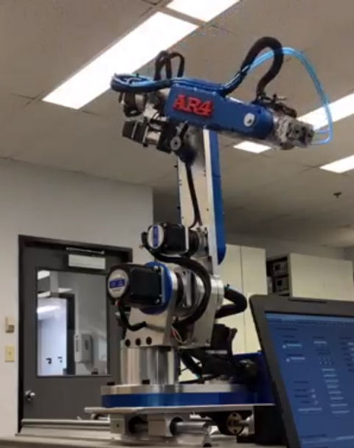
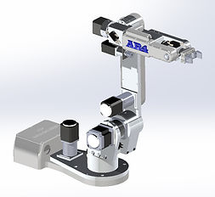
Changes Since PDR
Critical Design Changes
Return to 6DOF Robotic Arm design
  Design overhaul heavily based on Annin Robotics Inspiration
  Interpretation of original design
Changes made to:
  Appearance
  System interactions
  Coding suite
Advantages
  Efficiency in design process
Updates on where the team is at currently
Notes:
Put in pictures of OG Annin robotics robot, and CAD full assembly of current design, talk about new features, go into the use of several motors and return to 6DOF robot arm. Talk about how this has really helped out with the designing and manufacturing process, but obviously puts us at a time disadvantage to a degree. However, we have made excellent progress in the weeks following the design change and are on track to fully arrive at the desired

Slide 4
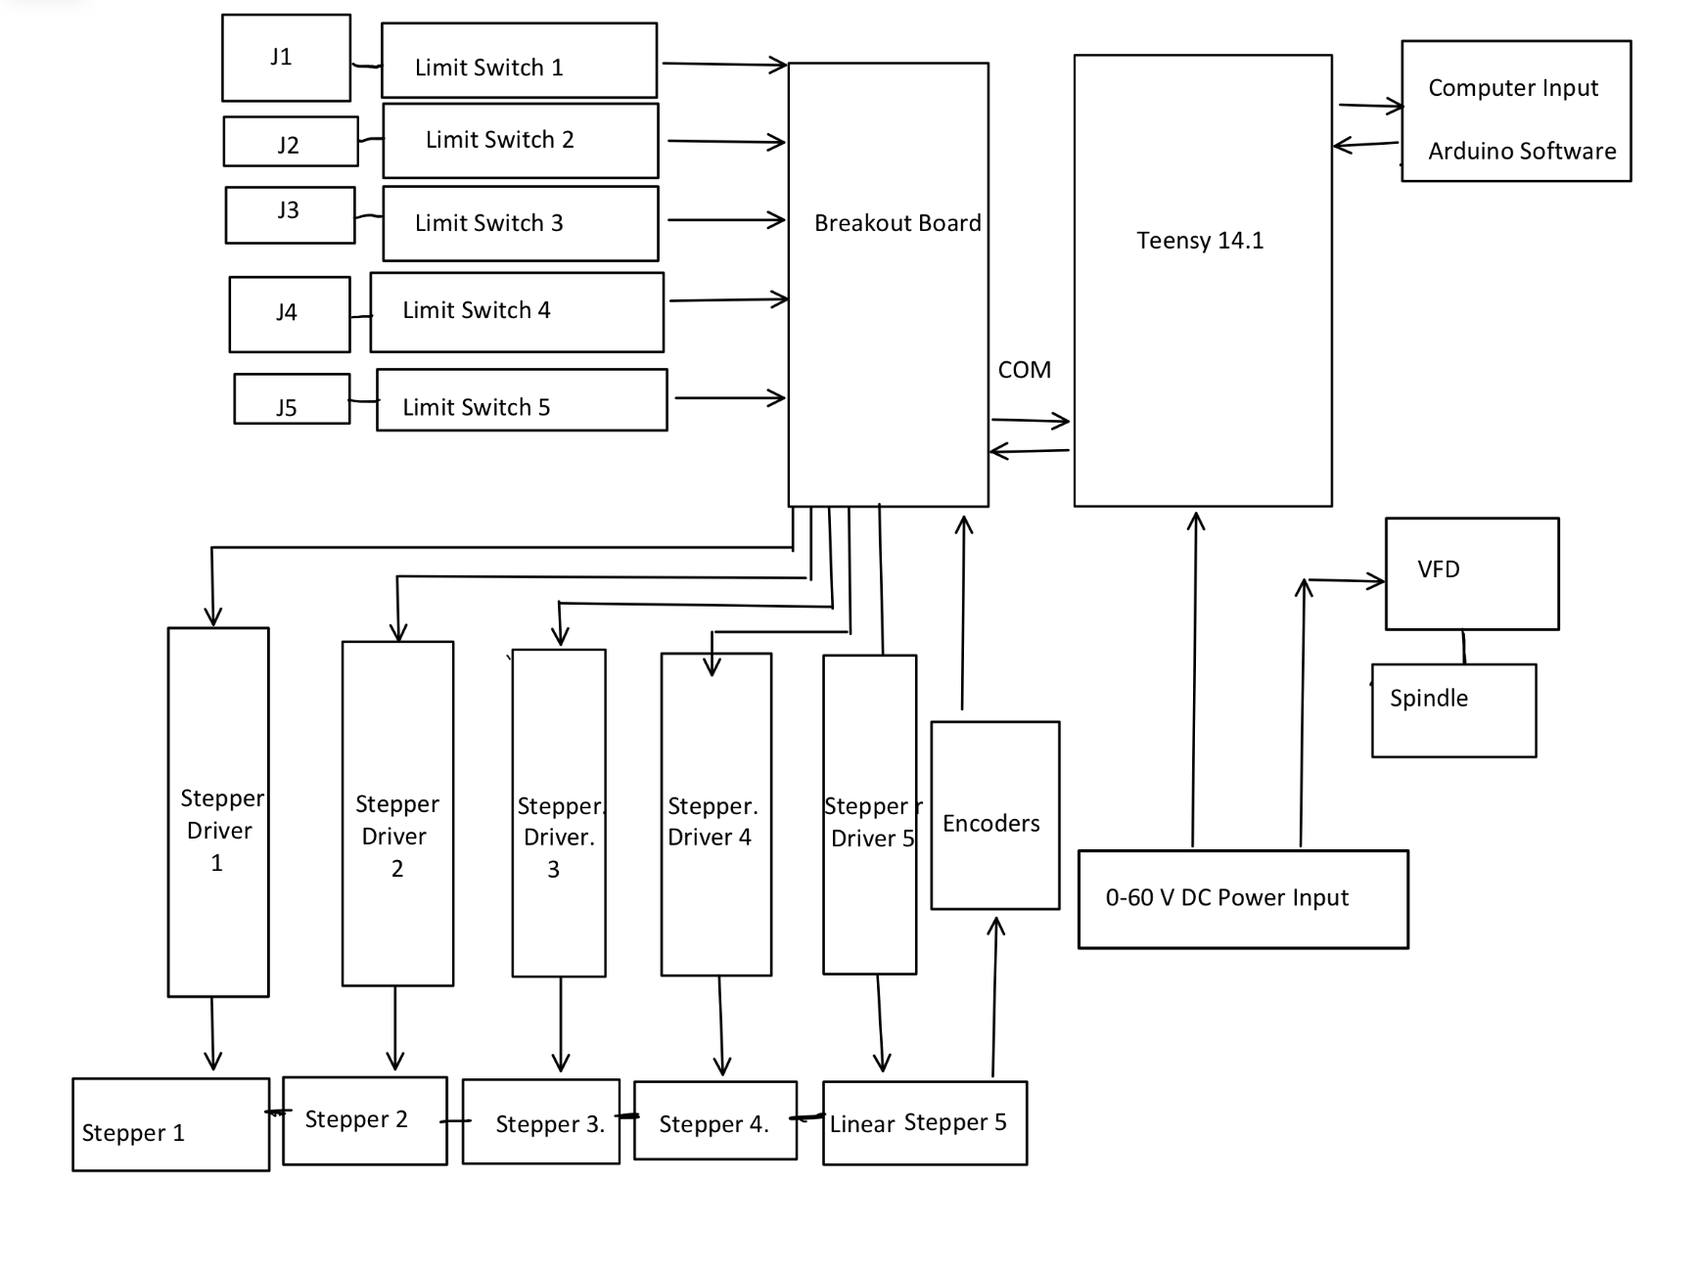
System Block Diagram
Updates
5 geared stepper motors to increase torque output
Magnetic Encoders
Teensy 14.1 with open source programming
Variable Frequency Drive to control Spindle Speed

Slide 5
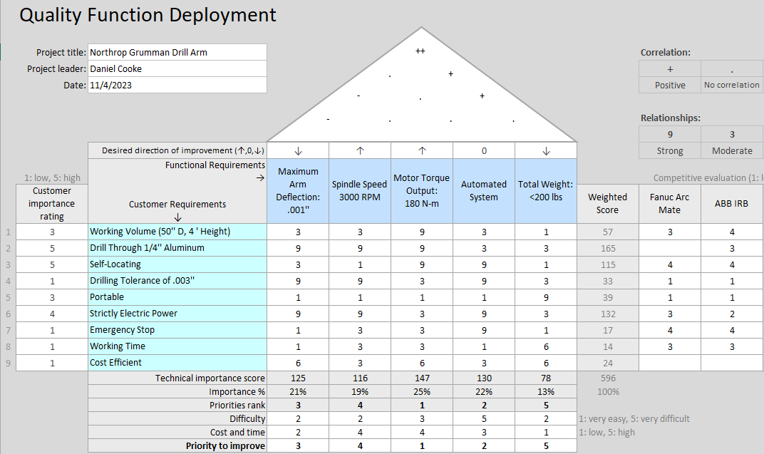
Requirements Review
text
Updated Requirements
For Final Presentation
Flat Aluminum Plate
Minimum 1 Axis of Rotation Functional
Priorities to Reach MVP
Motor Torque Output
Self Locating
Drilling Capabilities

Slide 6
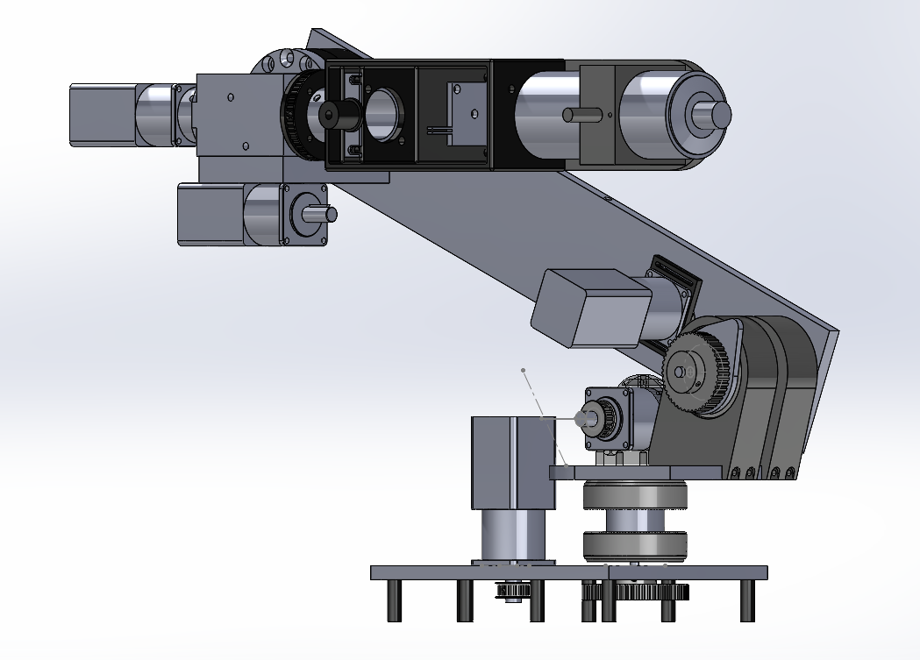
Design Details: Full Assembly

Slide 7
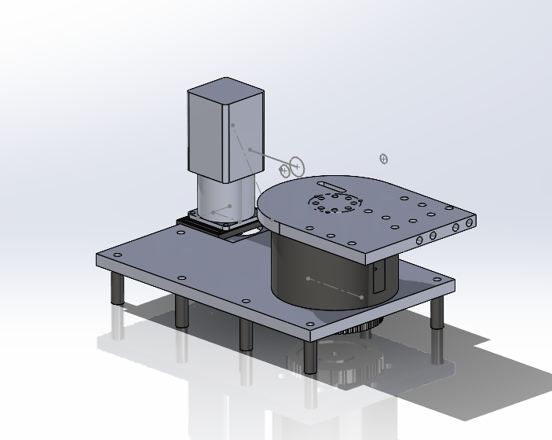
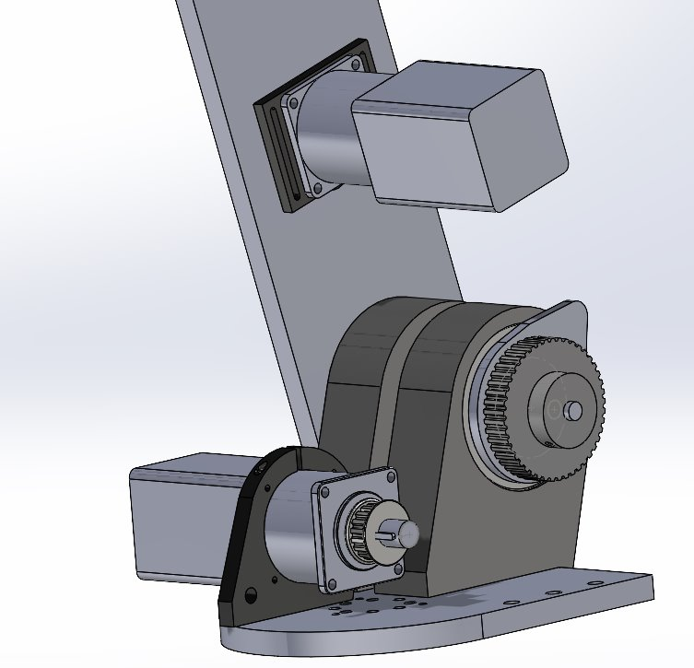
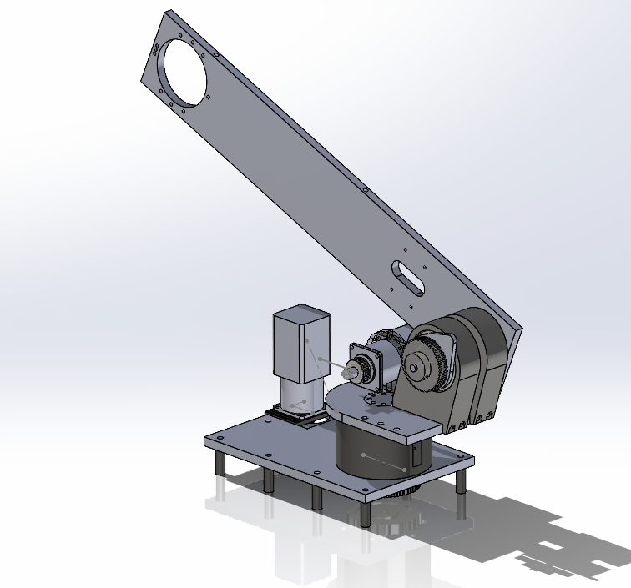
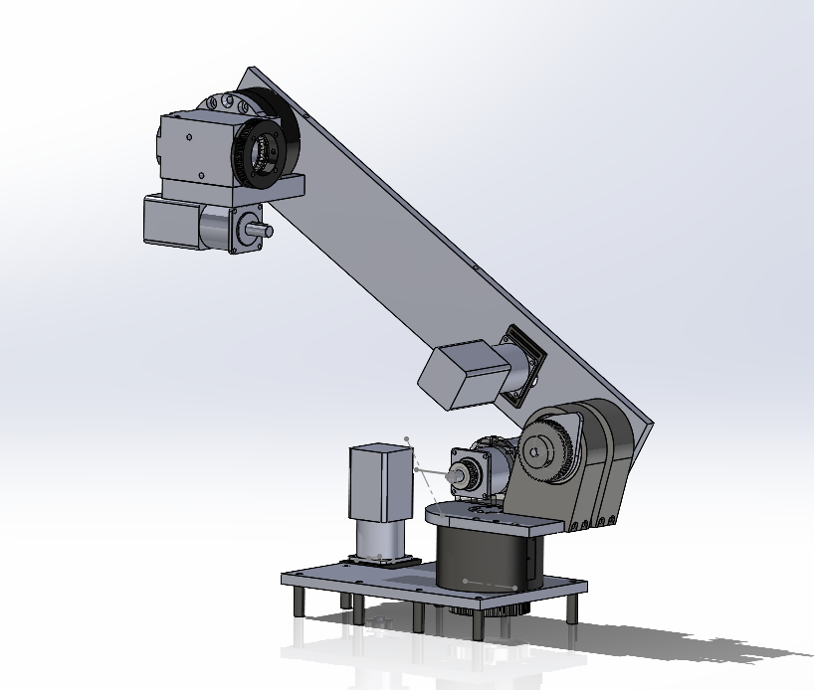
Design Details: Sub Assemblies
Joint 1
Joint 3
Joint 5/Joint 6
Joint 2
Joint 4/Joint 5

Slide 8
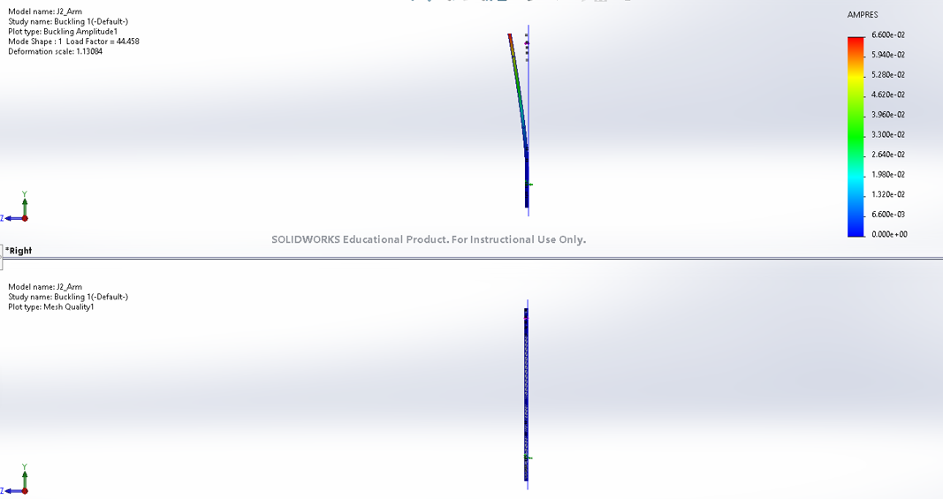
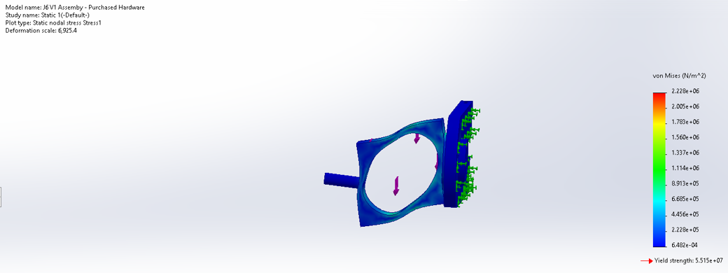
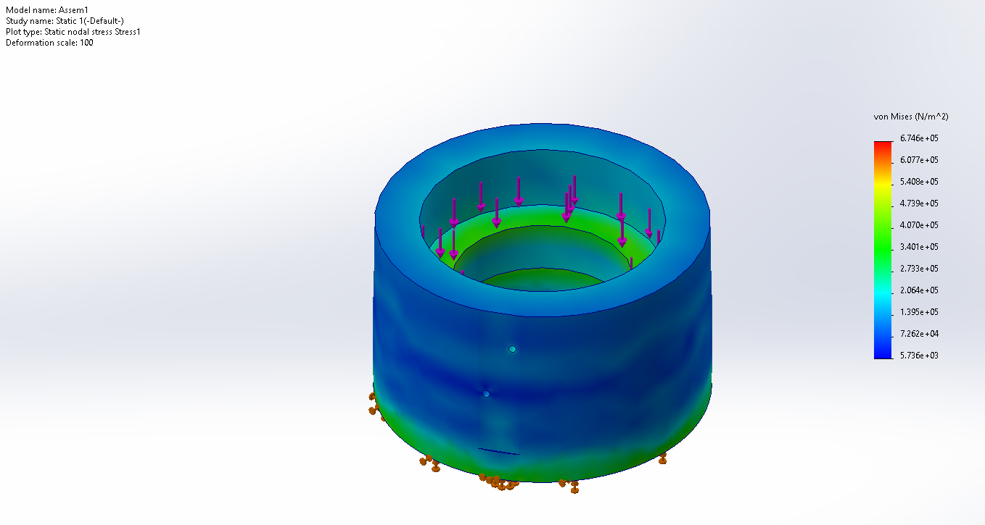
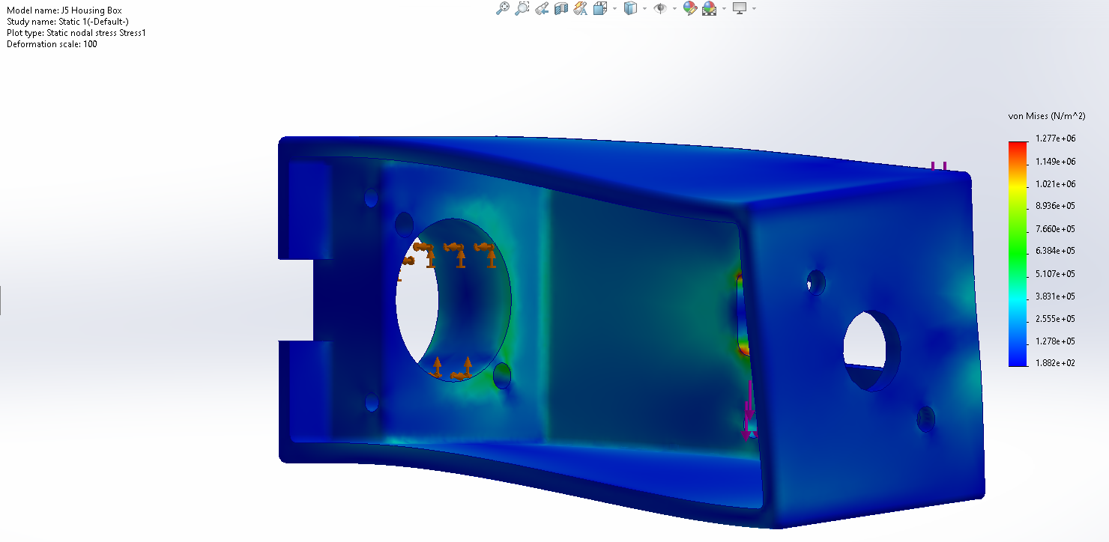
Design Details: FEA testing

Slide 9
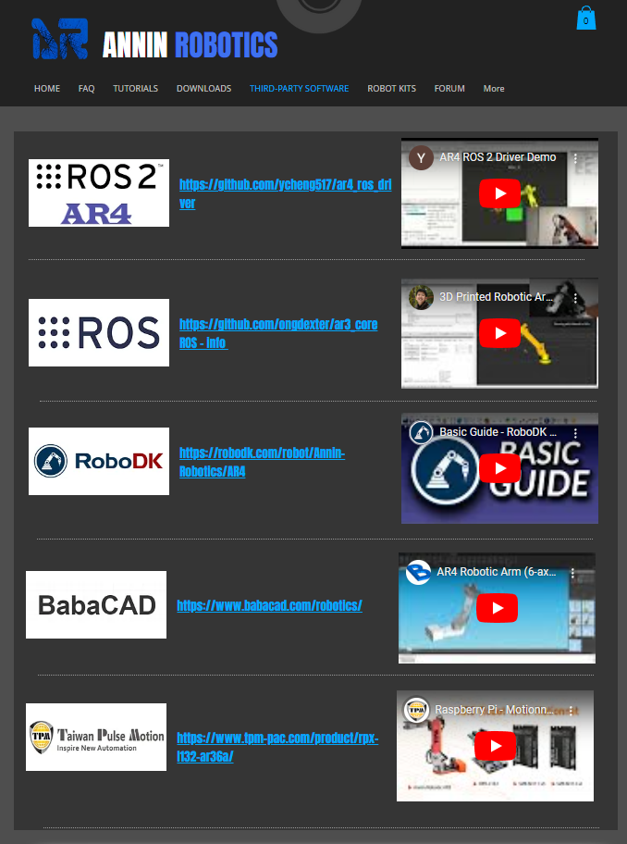
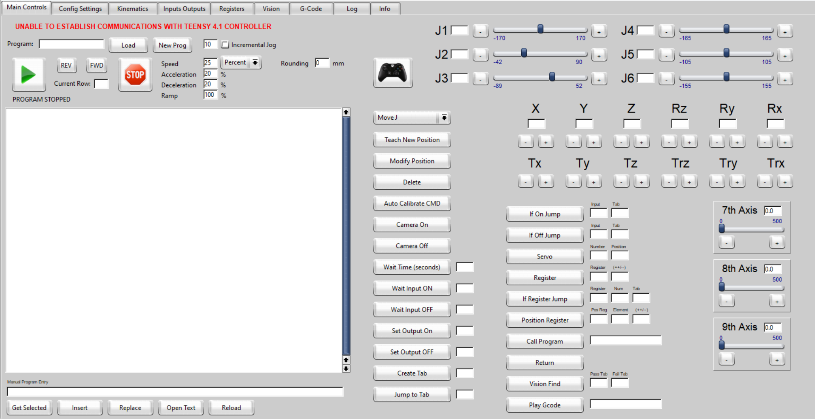
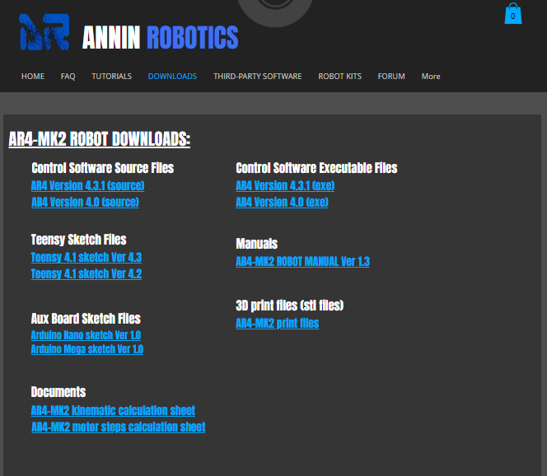
Design Details: Software

Slide 10
Analyses and Prediction
Electrical
  J1, J2, J3, J5, J6 Motors
  Spec sheets detail 4A rating
  10 A motor drivers for all motors to cover 125% recommendation
Torque-Speed
  Spec sheet indicate 48 V input voltage
  0 – Variable Supply
  0 – 50 A variability
PLA printed/ Machined
  J5 Turret Housing
    250 lb. load based on FEA – FOS 10
  J4 Turret Housing
  J2 Turret Housing
Holding Torque Main (J2) Arm
  1:50 Gear Ratio Motor
  1:2.5 Belt Driven Gearing
  100 N Torque for J2 Arm Movement

Slide 11
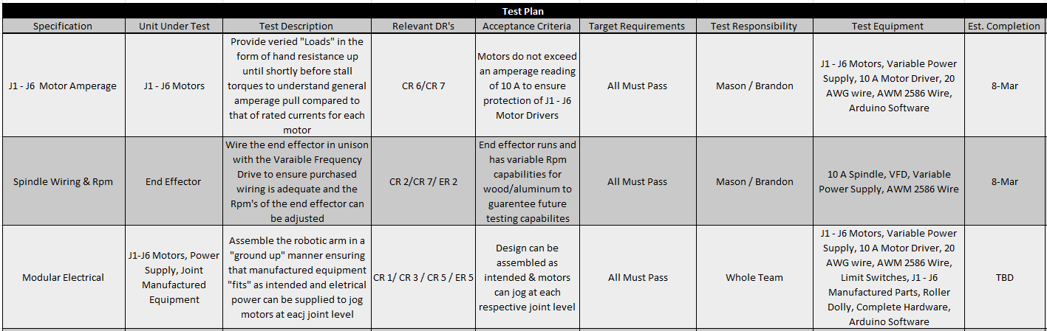
Verification Procedures/ Critical Test Methods

Slide 12
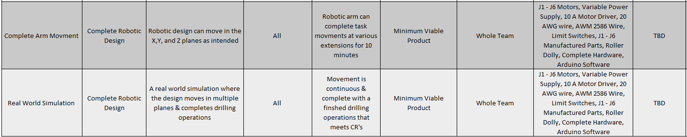
Verification Procedures/ Critical Test Methods

Slide 13
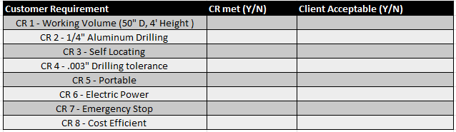
Data Sheets

Slide 14
Project Status
Milestones
Tasks | Date of Completion
Machine Shop Trained | 2/4/24
25% Manufactured | 2/7/24
50% Purchased | 2/7/24
100% Designed | 2/7/24
67% Manufactured | 2/28/24
100% Purchased | 2/28/24
Next Tasks
Tasks | Date of Completion
Finalize Testing Plan | 3/22/24
100% Manufactured | 3/26/24
Final Poster and PPT | 4/12/24
Final CAD Package | 4/13/24
Finalize Testing | 4/16/24
Final Report | 3/20/24
Website Completion | 4/21/24
NP Presentation | Week of April 22 or 29
UGRADS Presentation | 4/26/24
Notes:
Parts, drawings and design documents listed in IDL format with status. Project Plan clearly presented. Milestones, tasks, and critical path well understood. Next tasks presented.

Slide 15
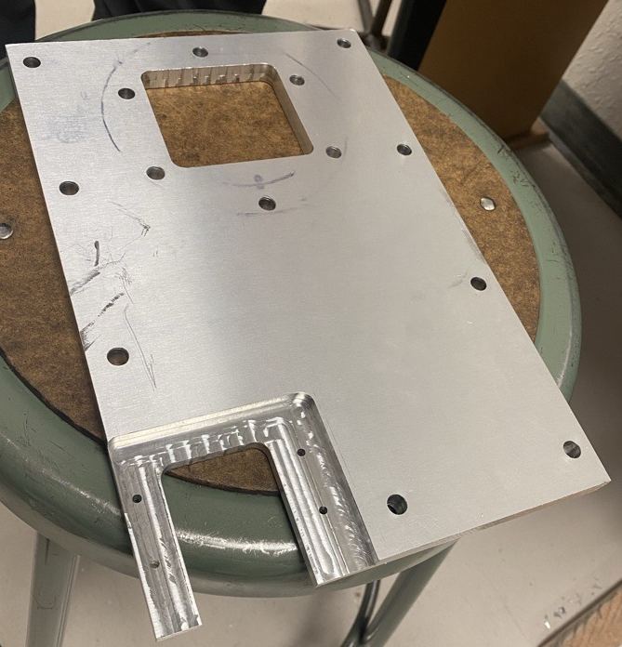
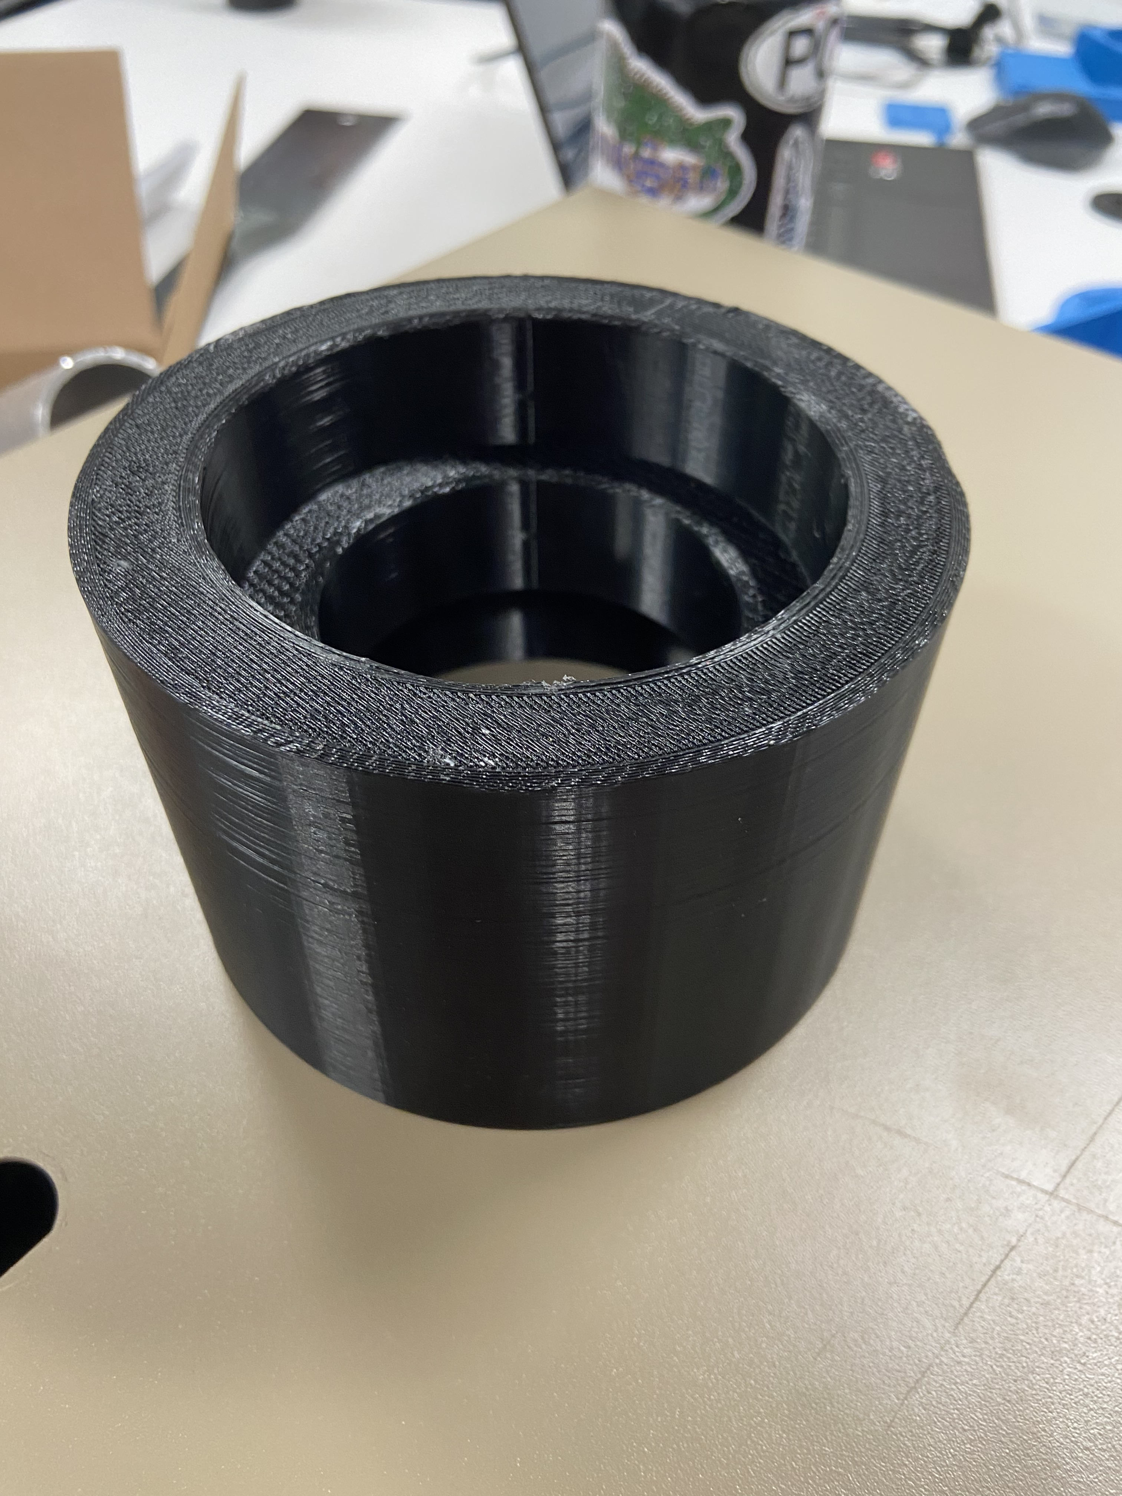
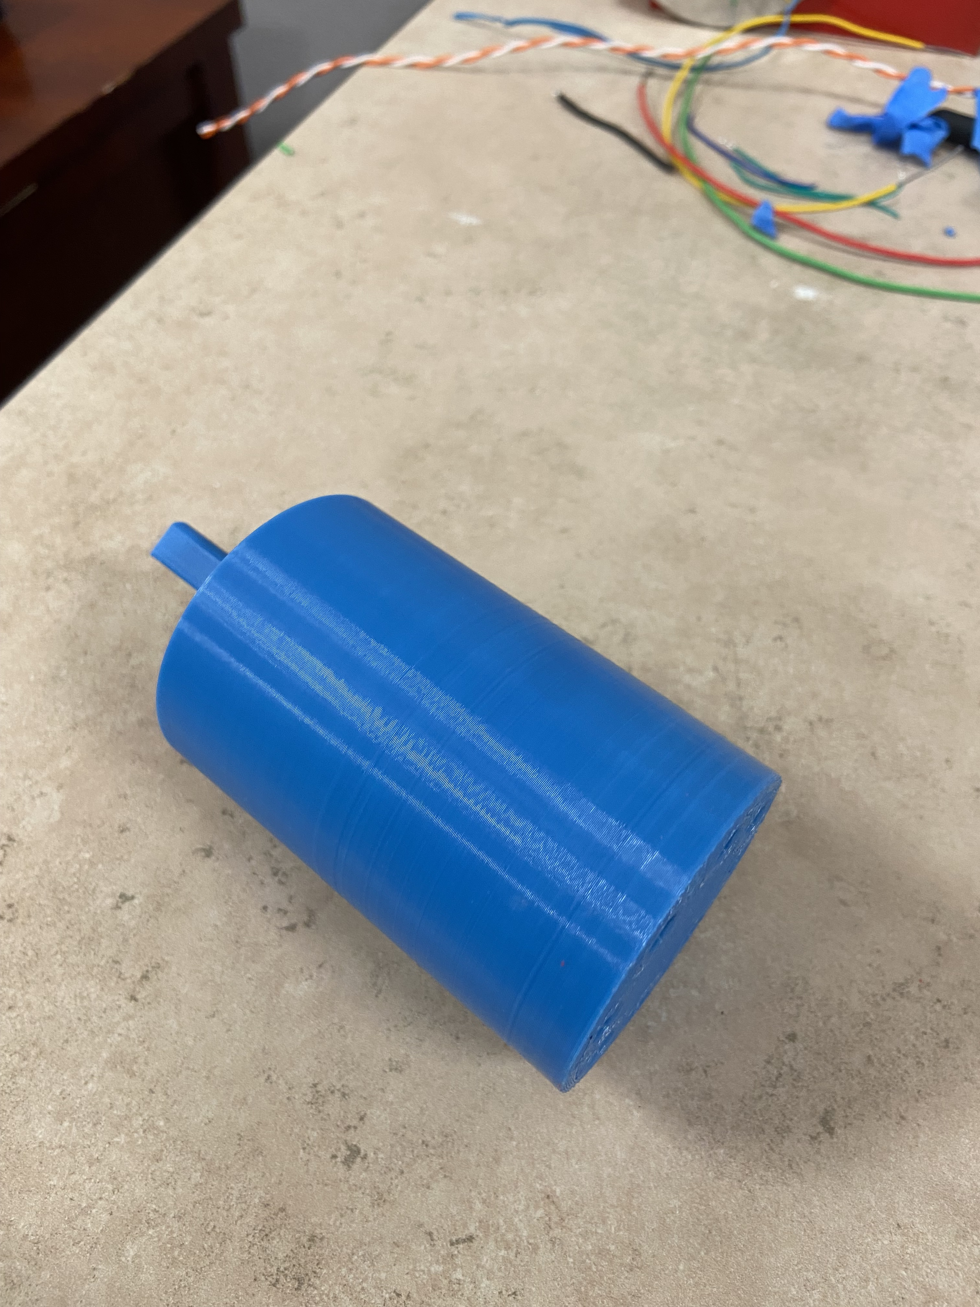
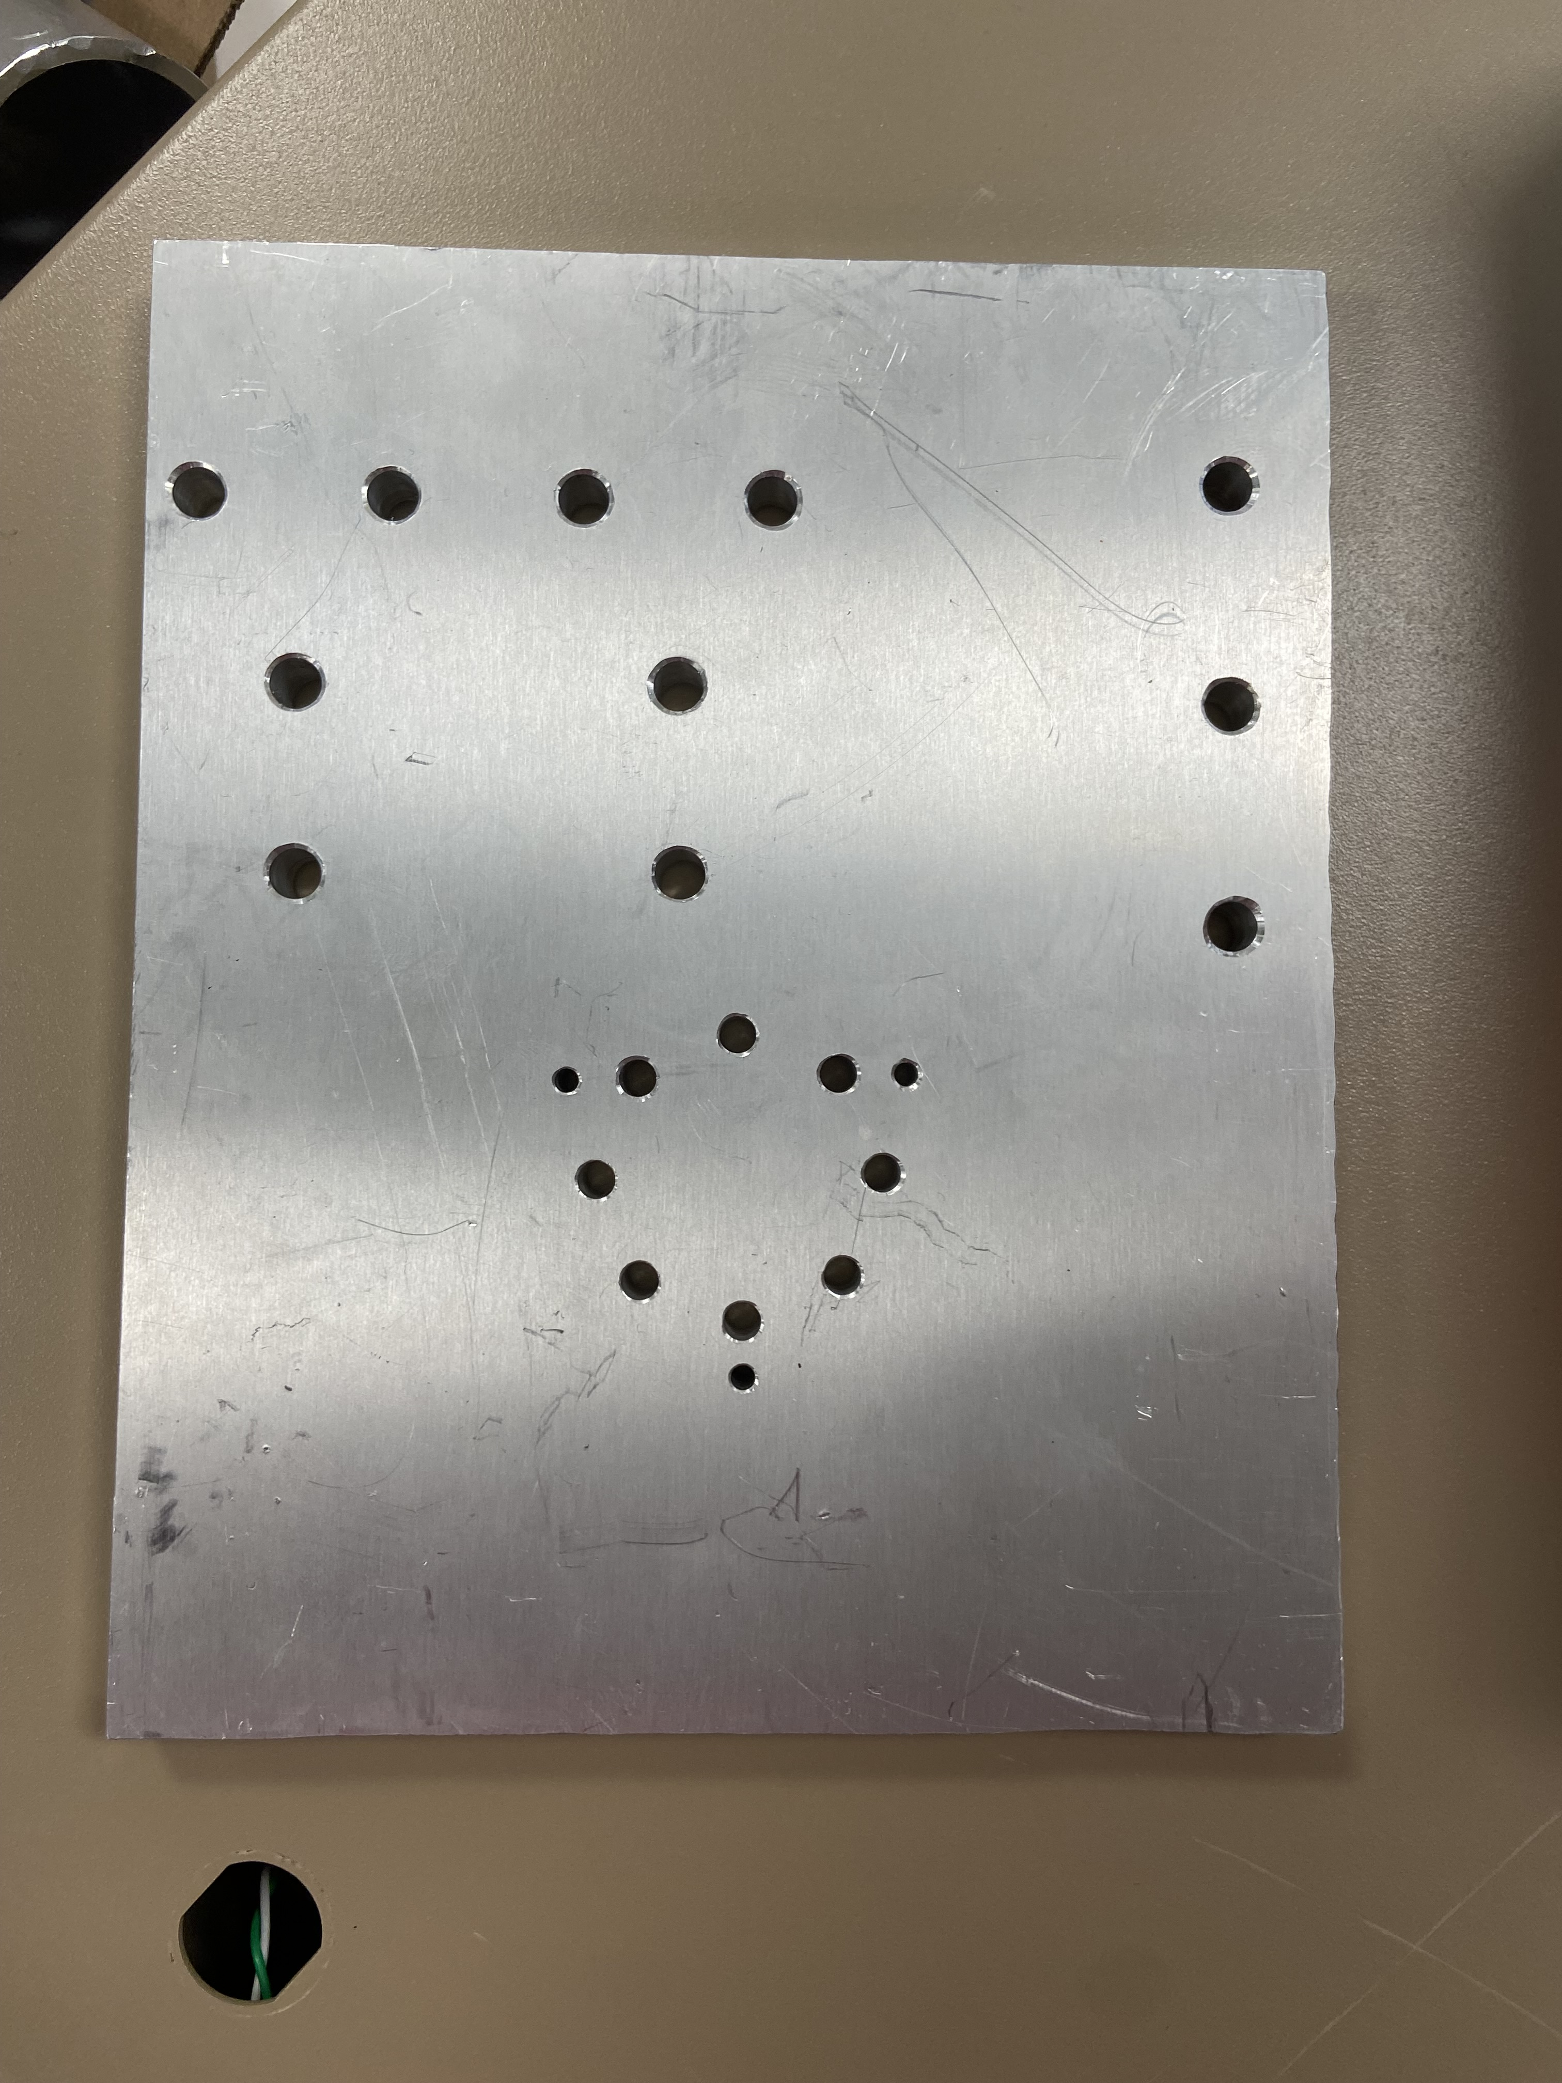
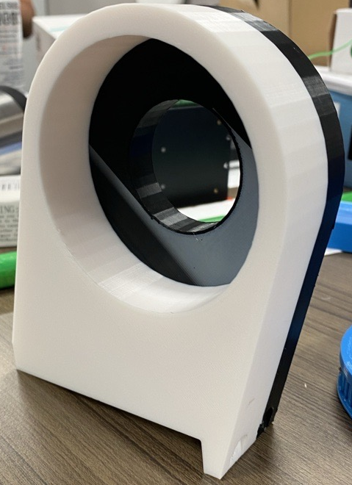
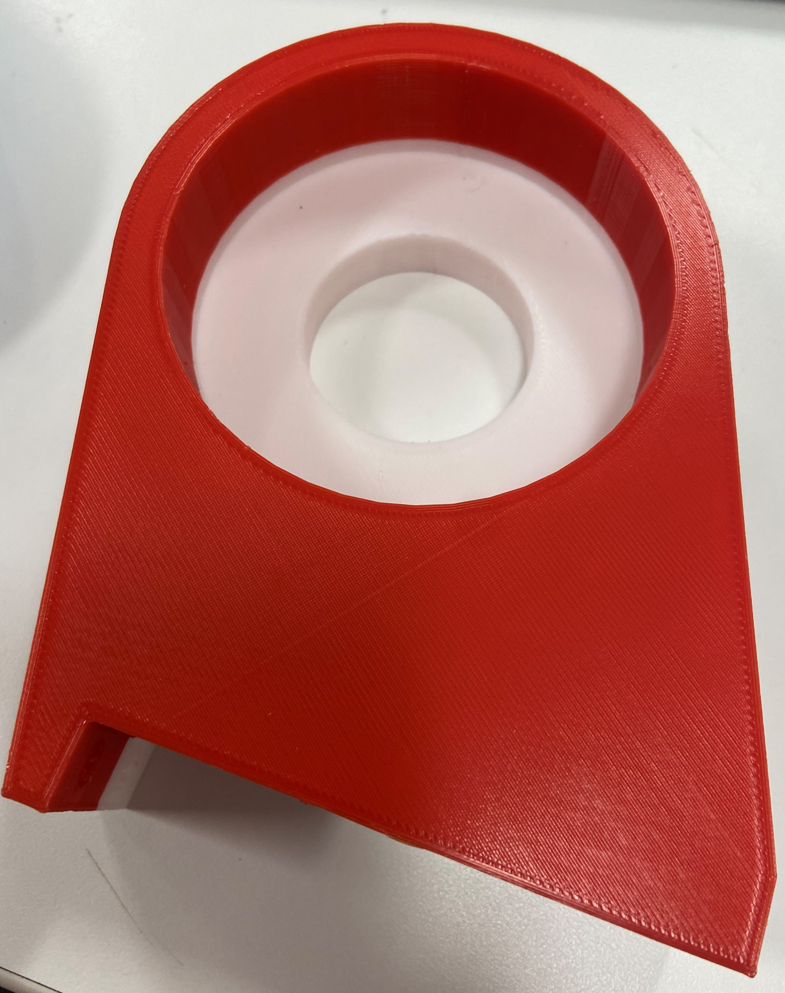
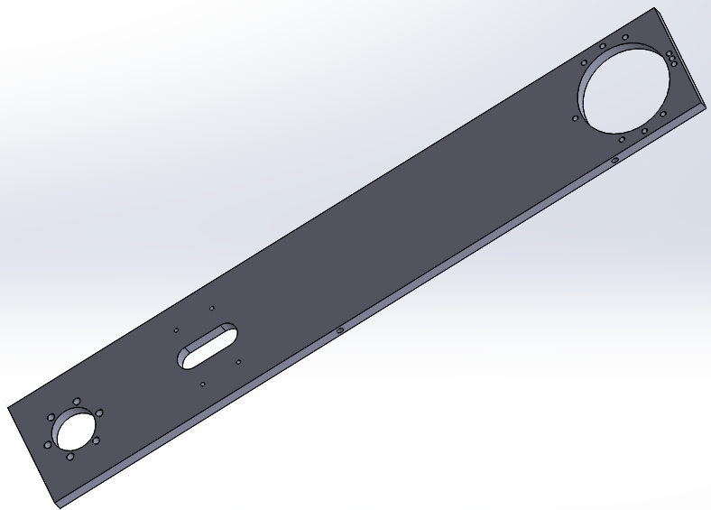
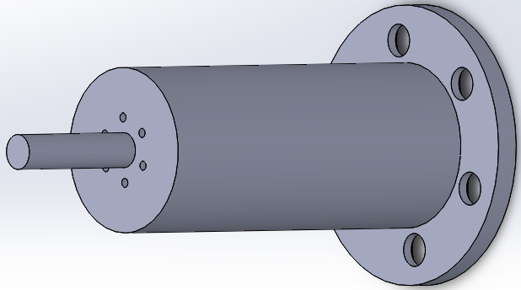
Project Status – Manufacturing Update
Part # | Description | Material | Time to Manufacture | Joint | Picture
1 | Base Plate | Aluminum | 5 | 1
2 | Turret Housing | PLA | 48 | 1
3 | Spindle | Aluminum | 8 | 1
4 | Turret Base | Aluminum | 4 | 1
5 | Turret Housing | PLA | 84 | 2
6 | Main Arm | Aluminum | 5 | 2
7 | Drive Spindle | Aluminum | 8 | 2

Slide 16
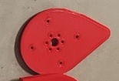

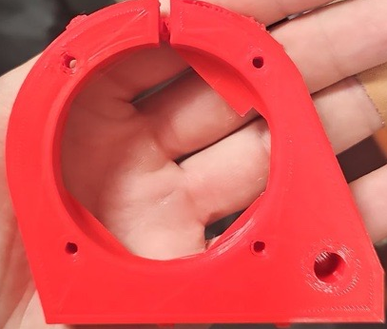
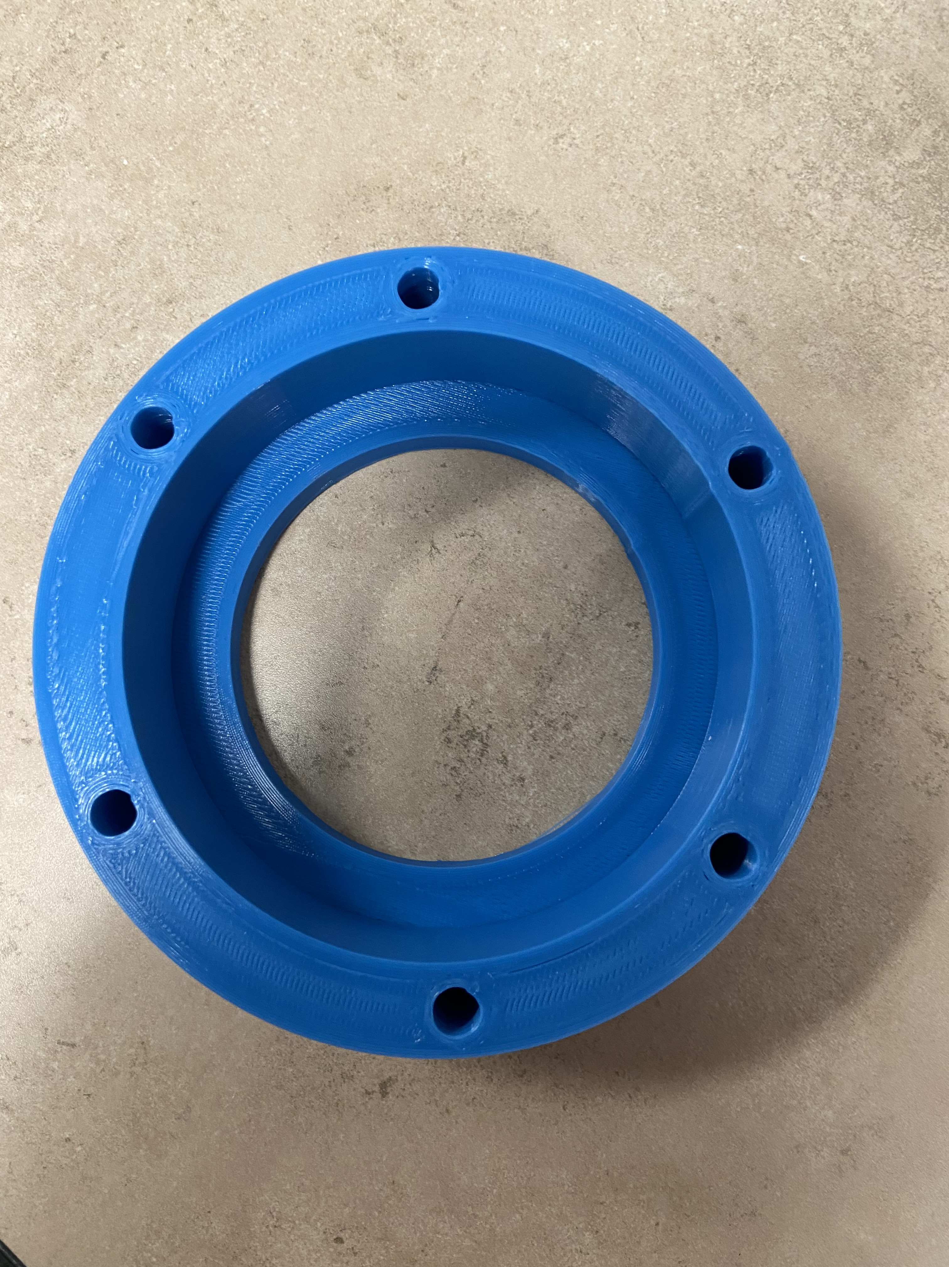
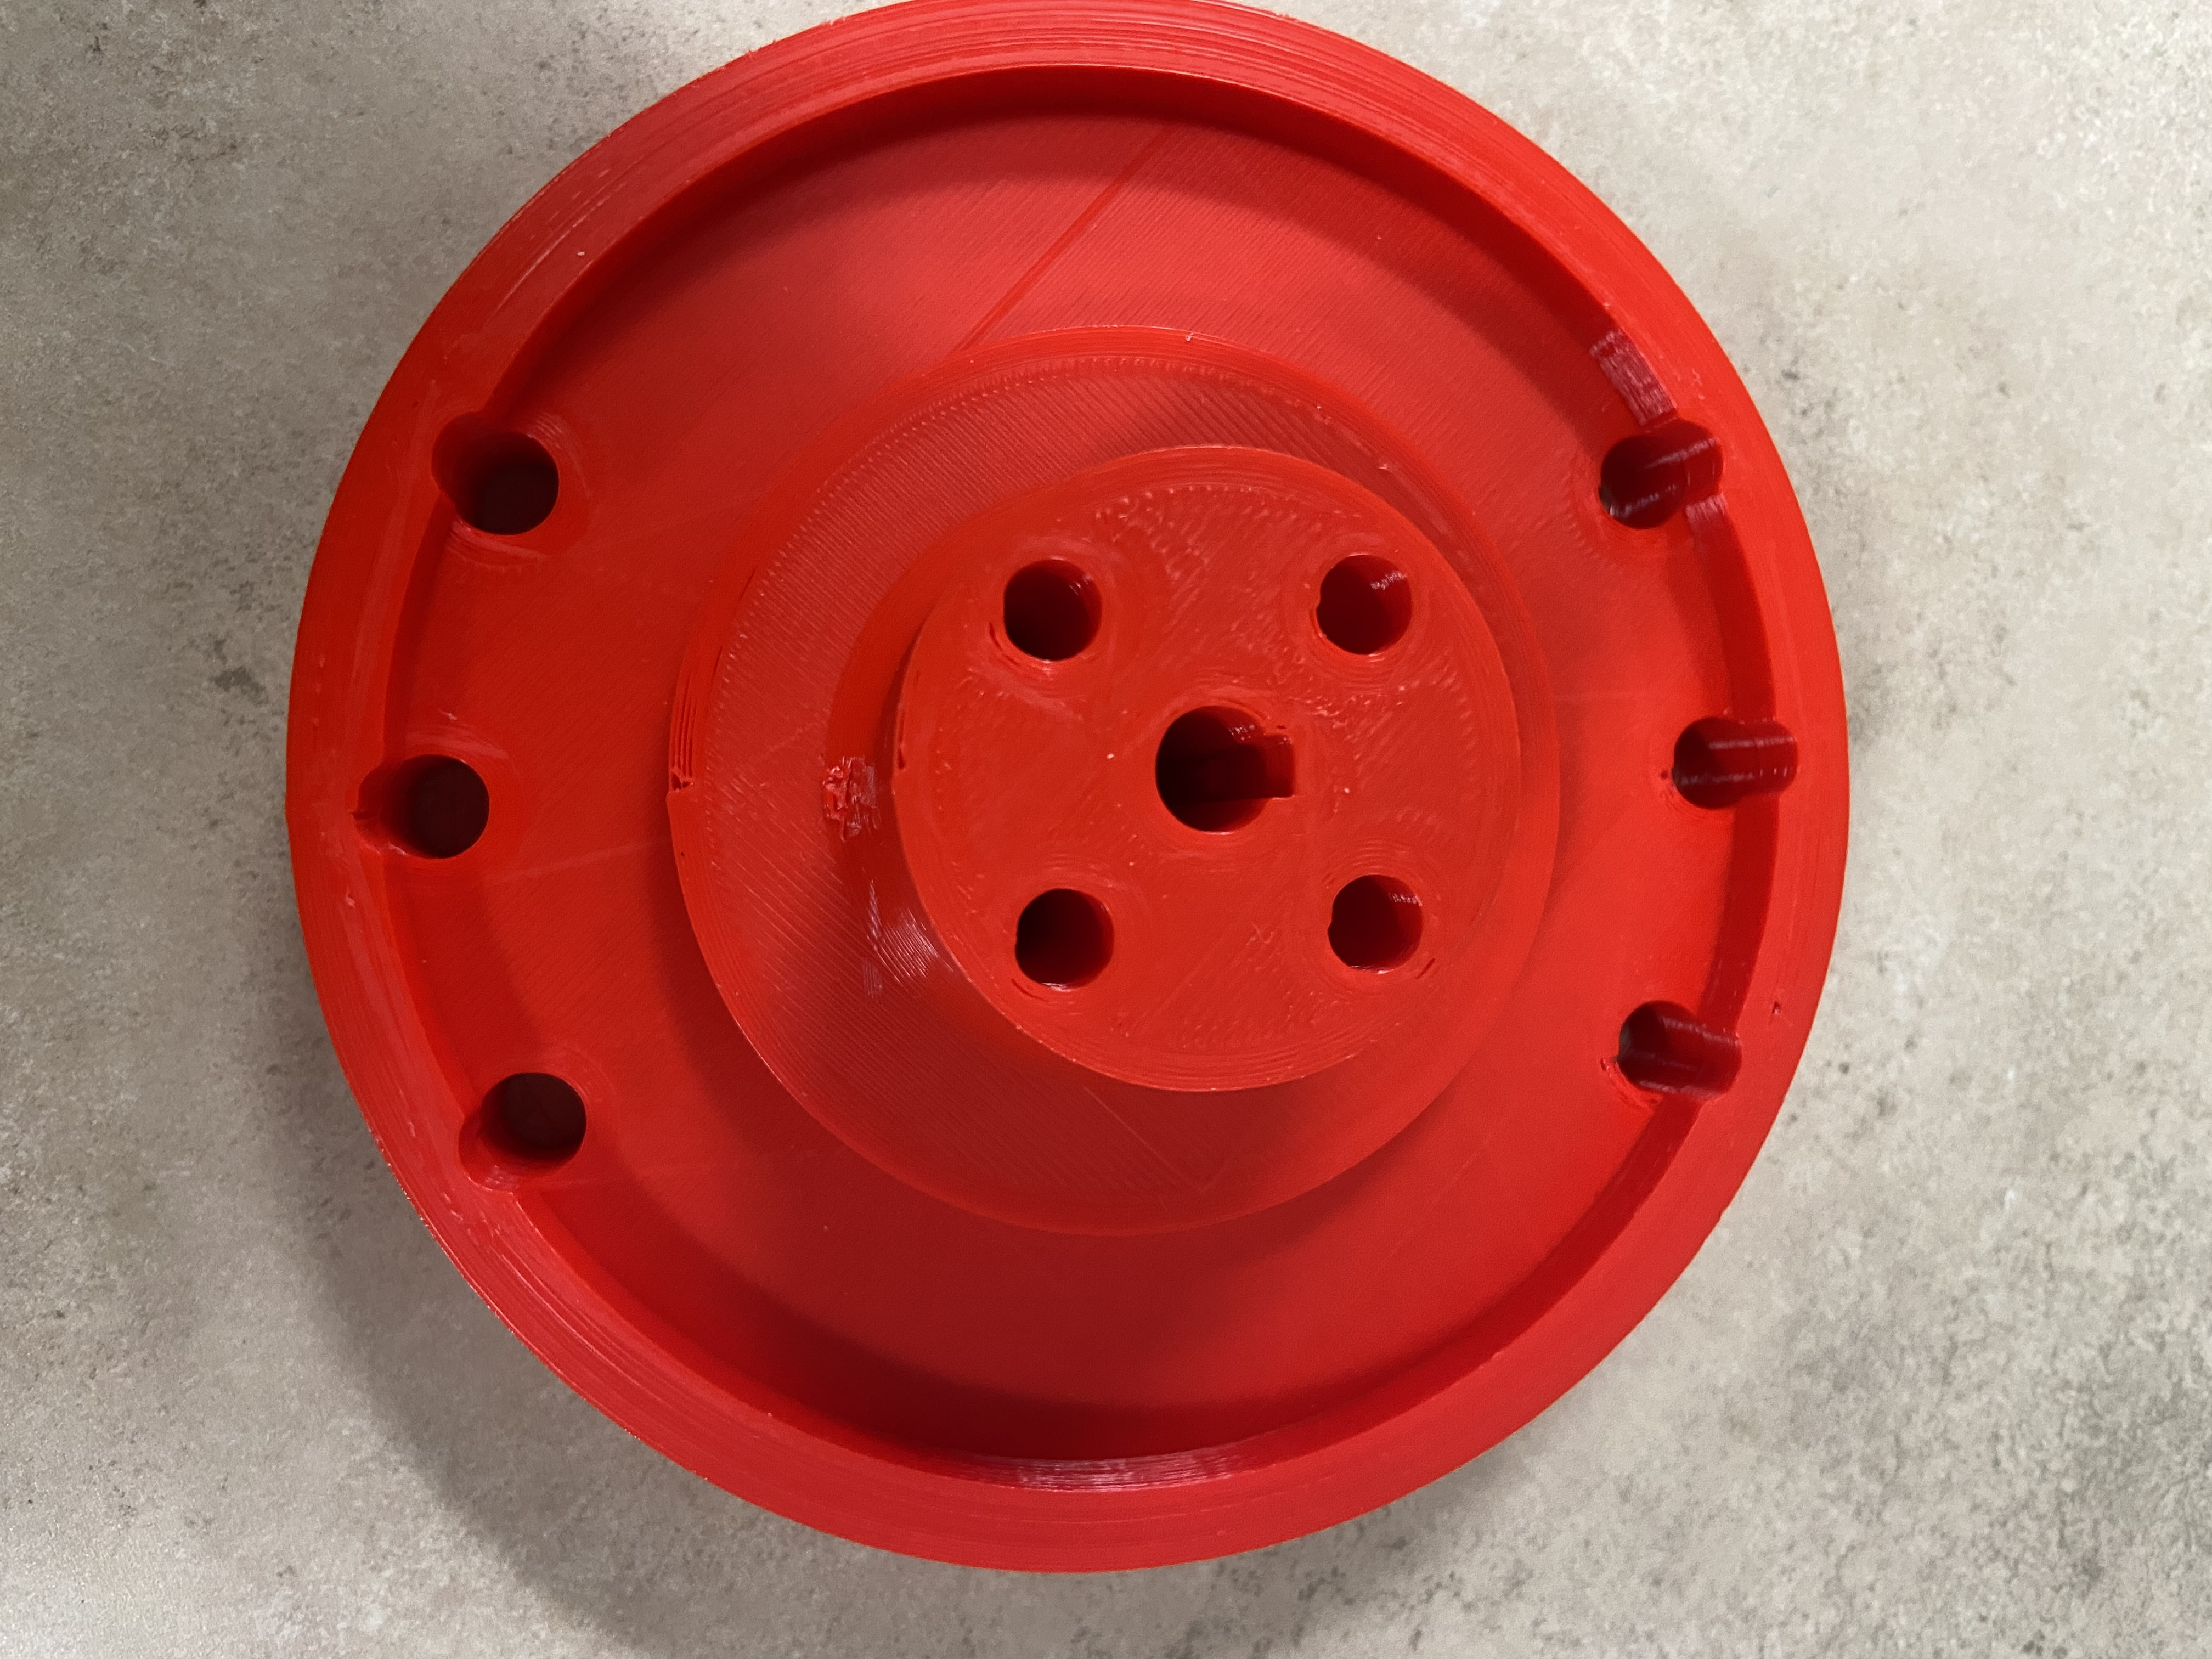
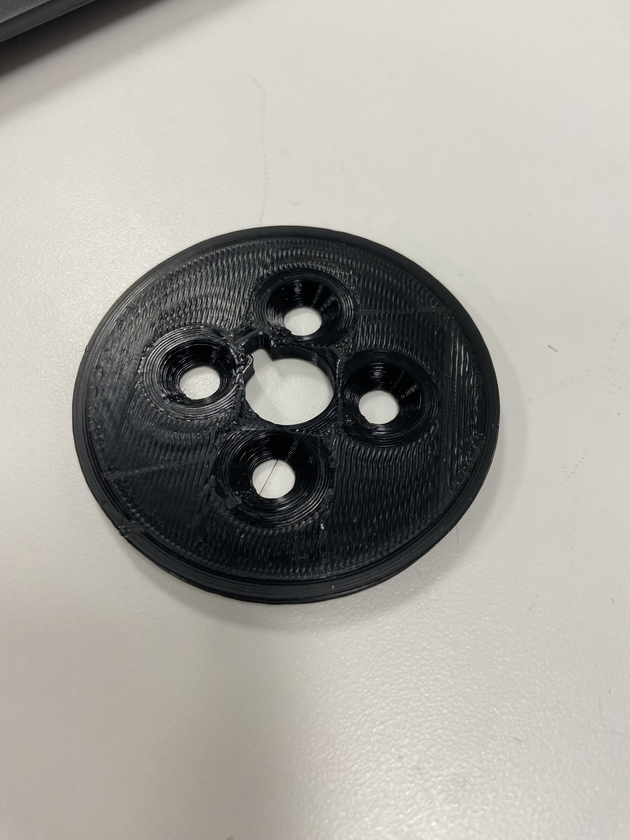
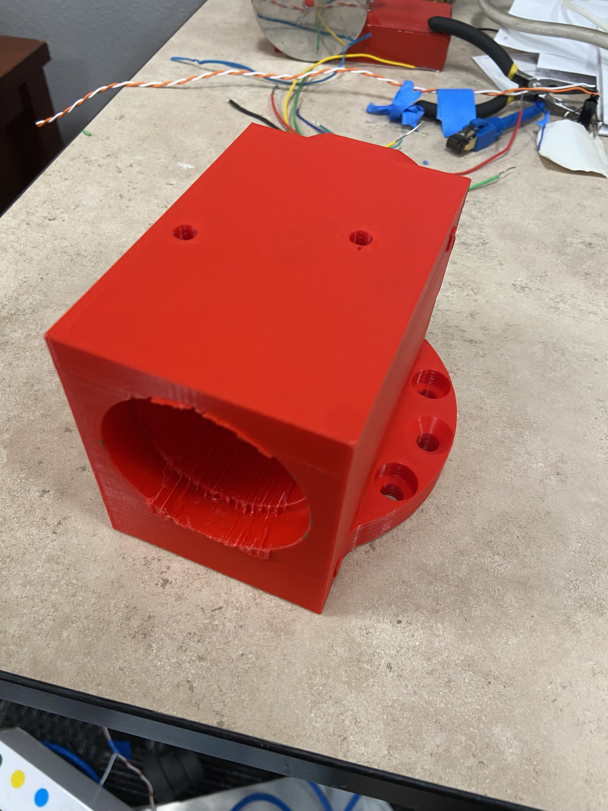
Project Status – Manufacturing Update
Part # | Description | Material | Time to Manufacture | Joint | Picture
8 | Tension Ring | PLA | 1 | 2
9 | Motor Mount | PLA | 1 | 1/3
10 | Motor Supports | PLA | 1.5 | 2
11 | Bearing Cup | PLA | 9 | 3
12 | Spindle 3 | PLA | 9 | 3
13 | Spindle 3 Retainer | PLA | 1 | 3
14 | Turret Housing 4 | PLA | 26 | 4

Slide 17
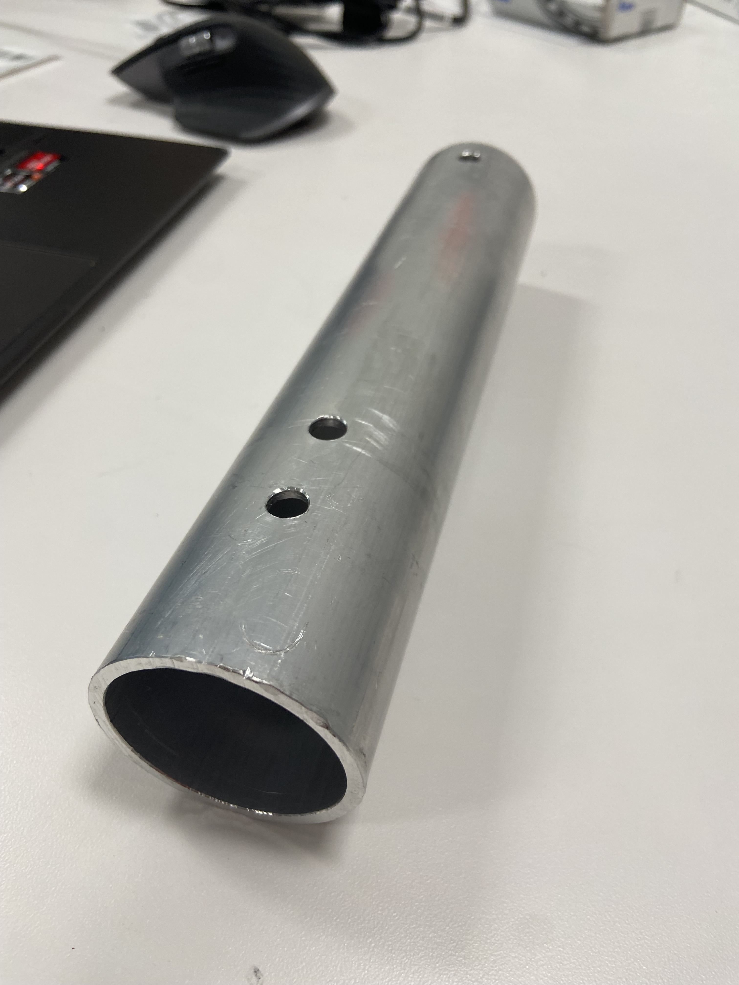
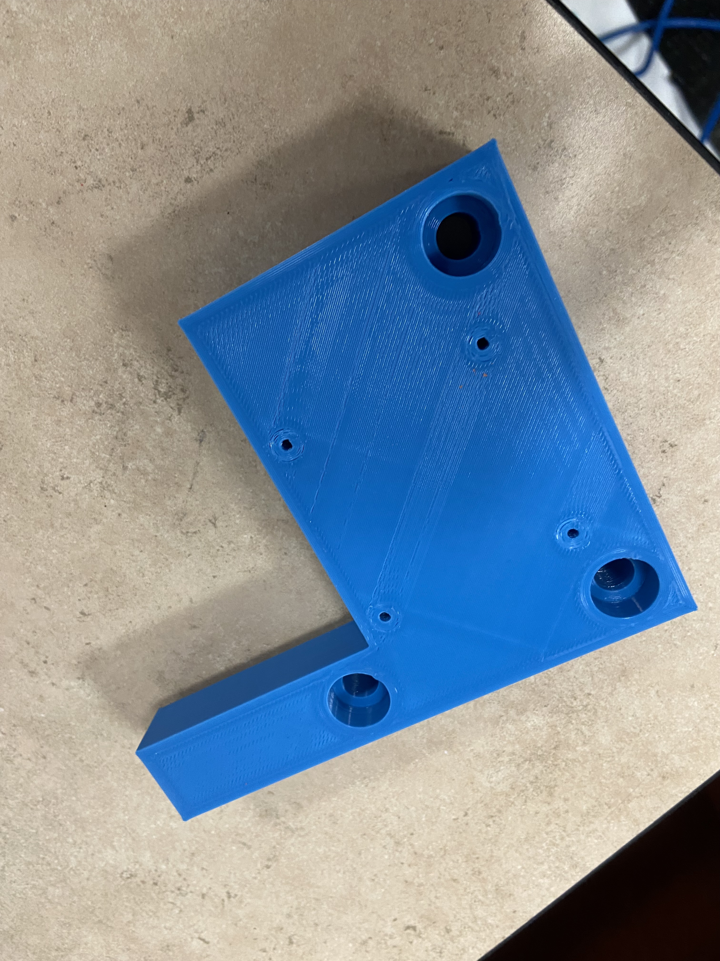
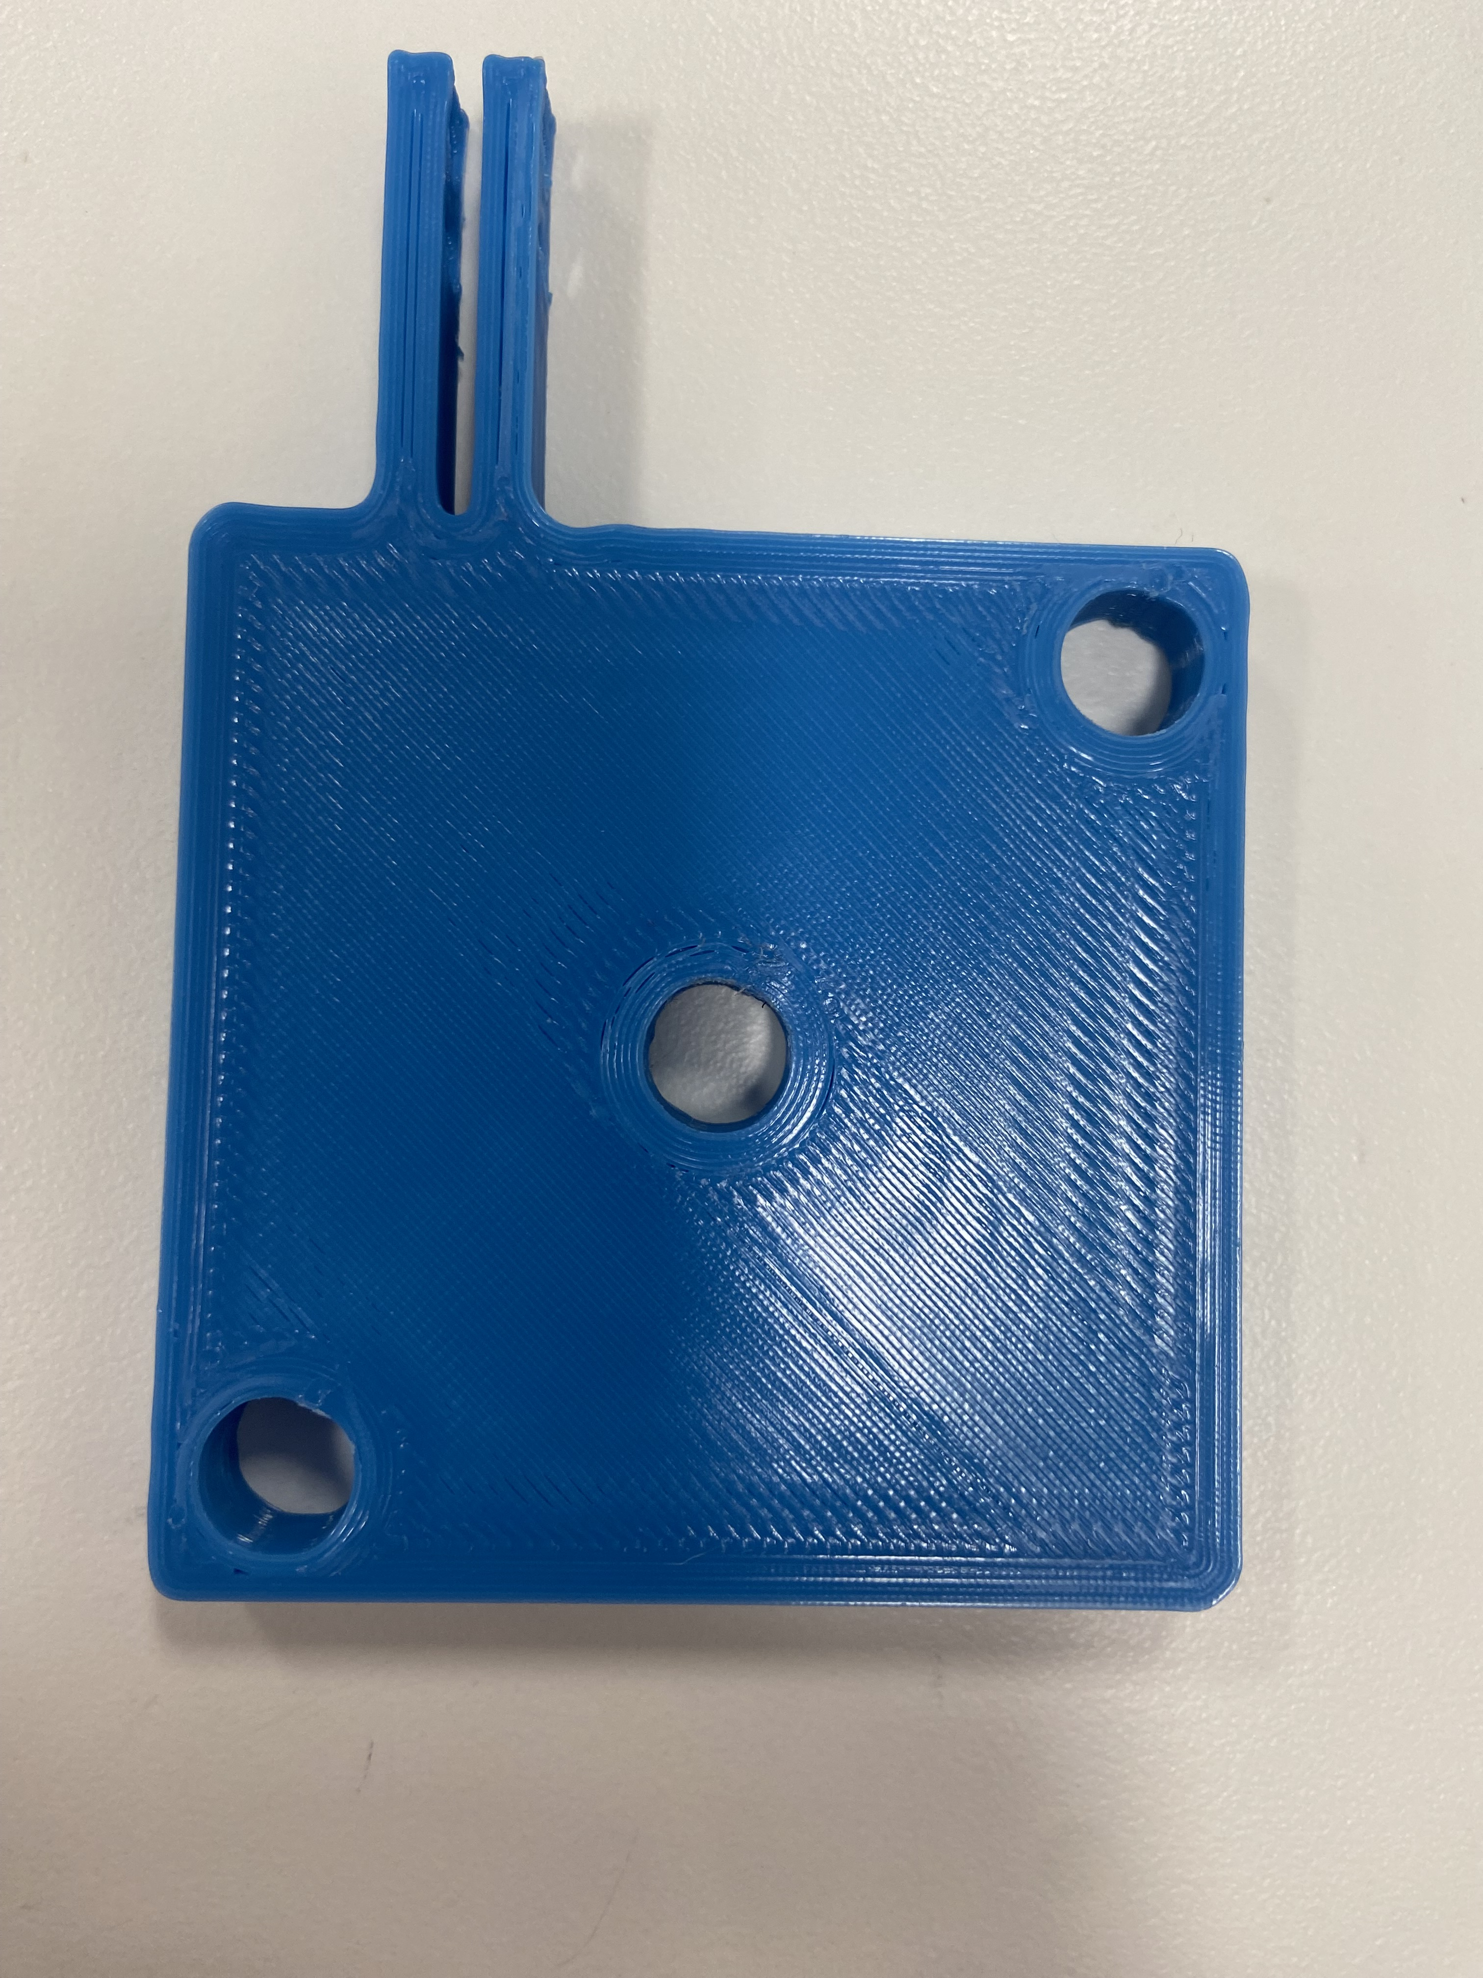
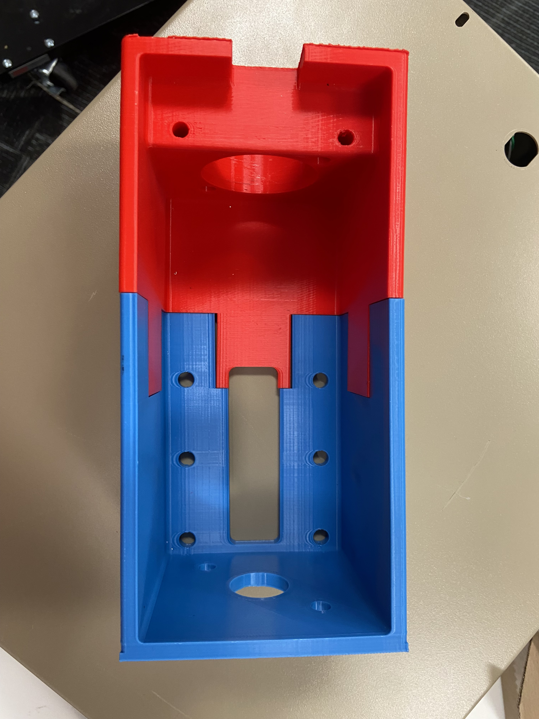
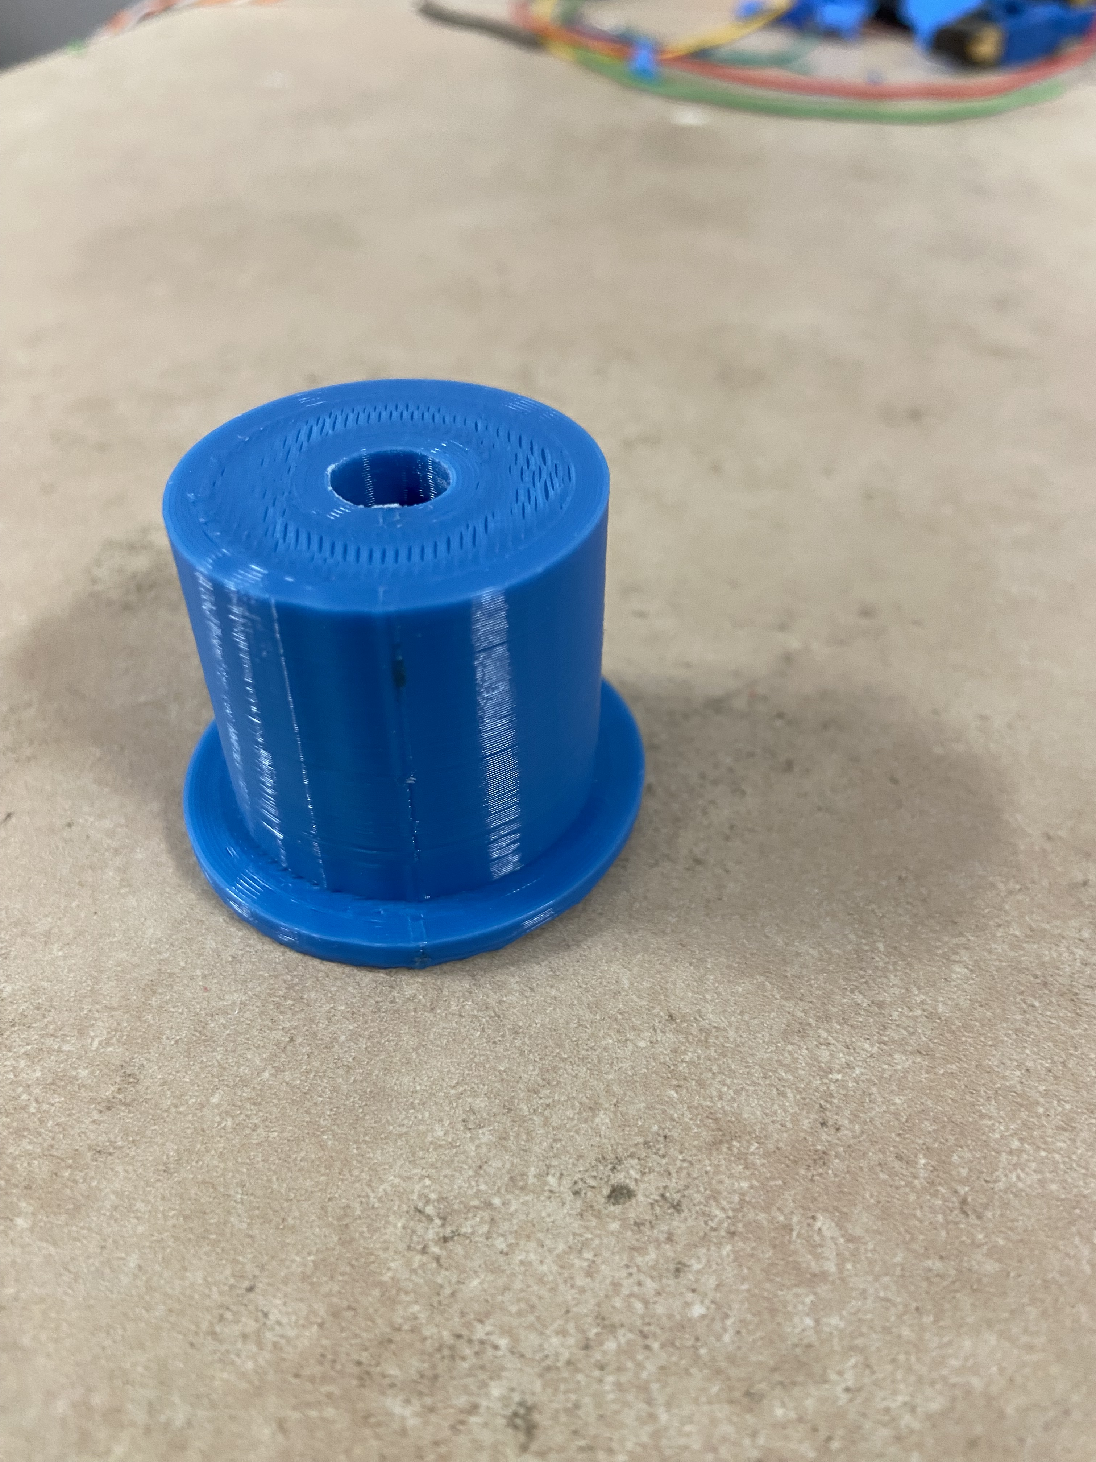
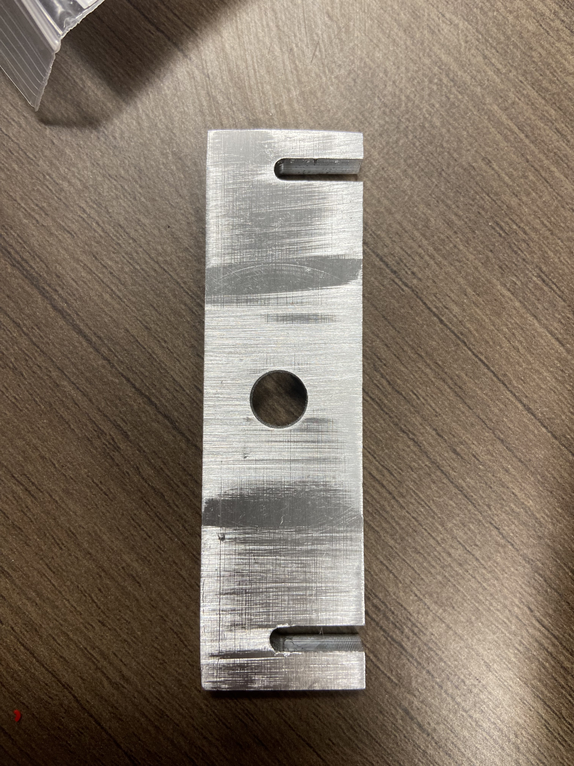
Project Status – Manufacturing Update
Part # | Description | Material | Time to Manufacture | Joint | Picture
15 | Main Shaft | Aluminum | 1 | 4
16 | Round Motor Mount | PLA | 3 | 5
17 | L Motor Mount | PLA | 2.8 | 4
18 | Belt Carrier/Clamp | PLA | 2.8 | 5
19 | Housing | PLA | 48 | 5
20 | Bearing Post | Aluminum | 2.8 | 5
21 | Tension Block | Aluminum | 1 | 5

Slide 18
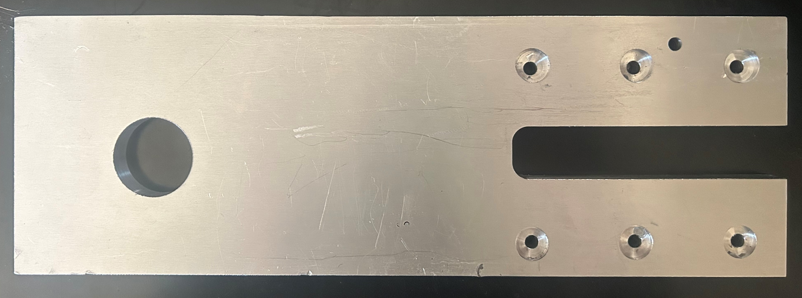
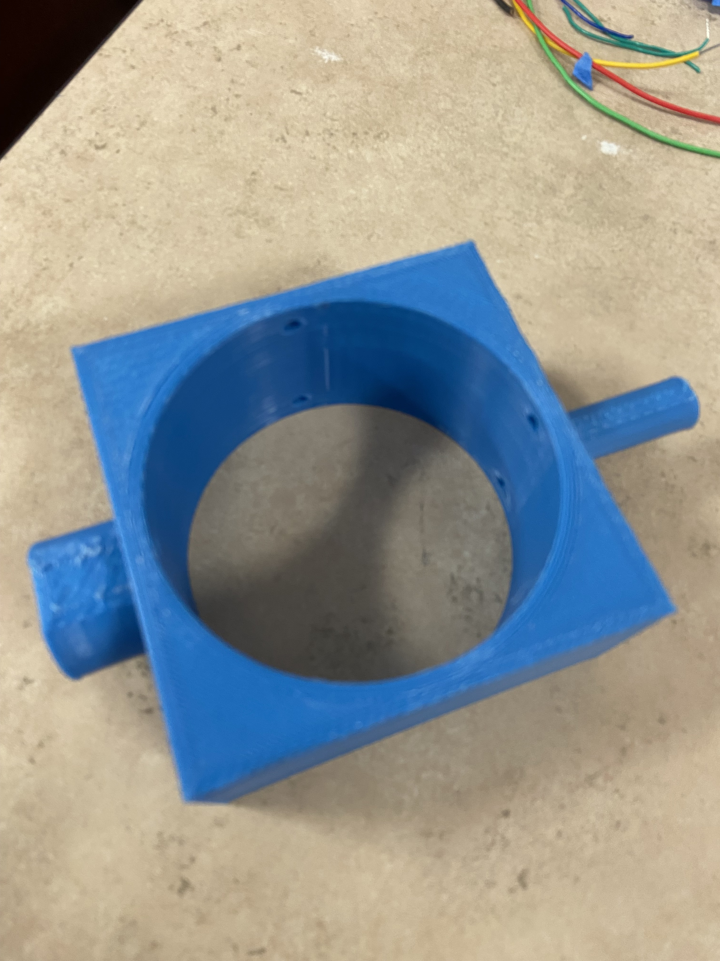
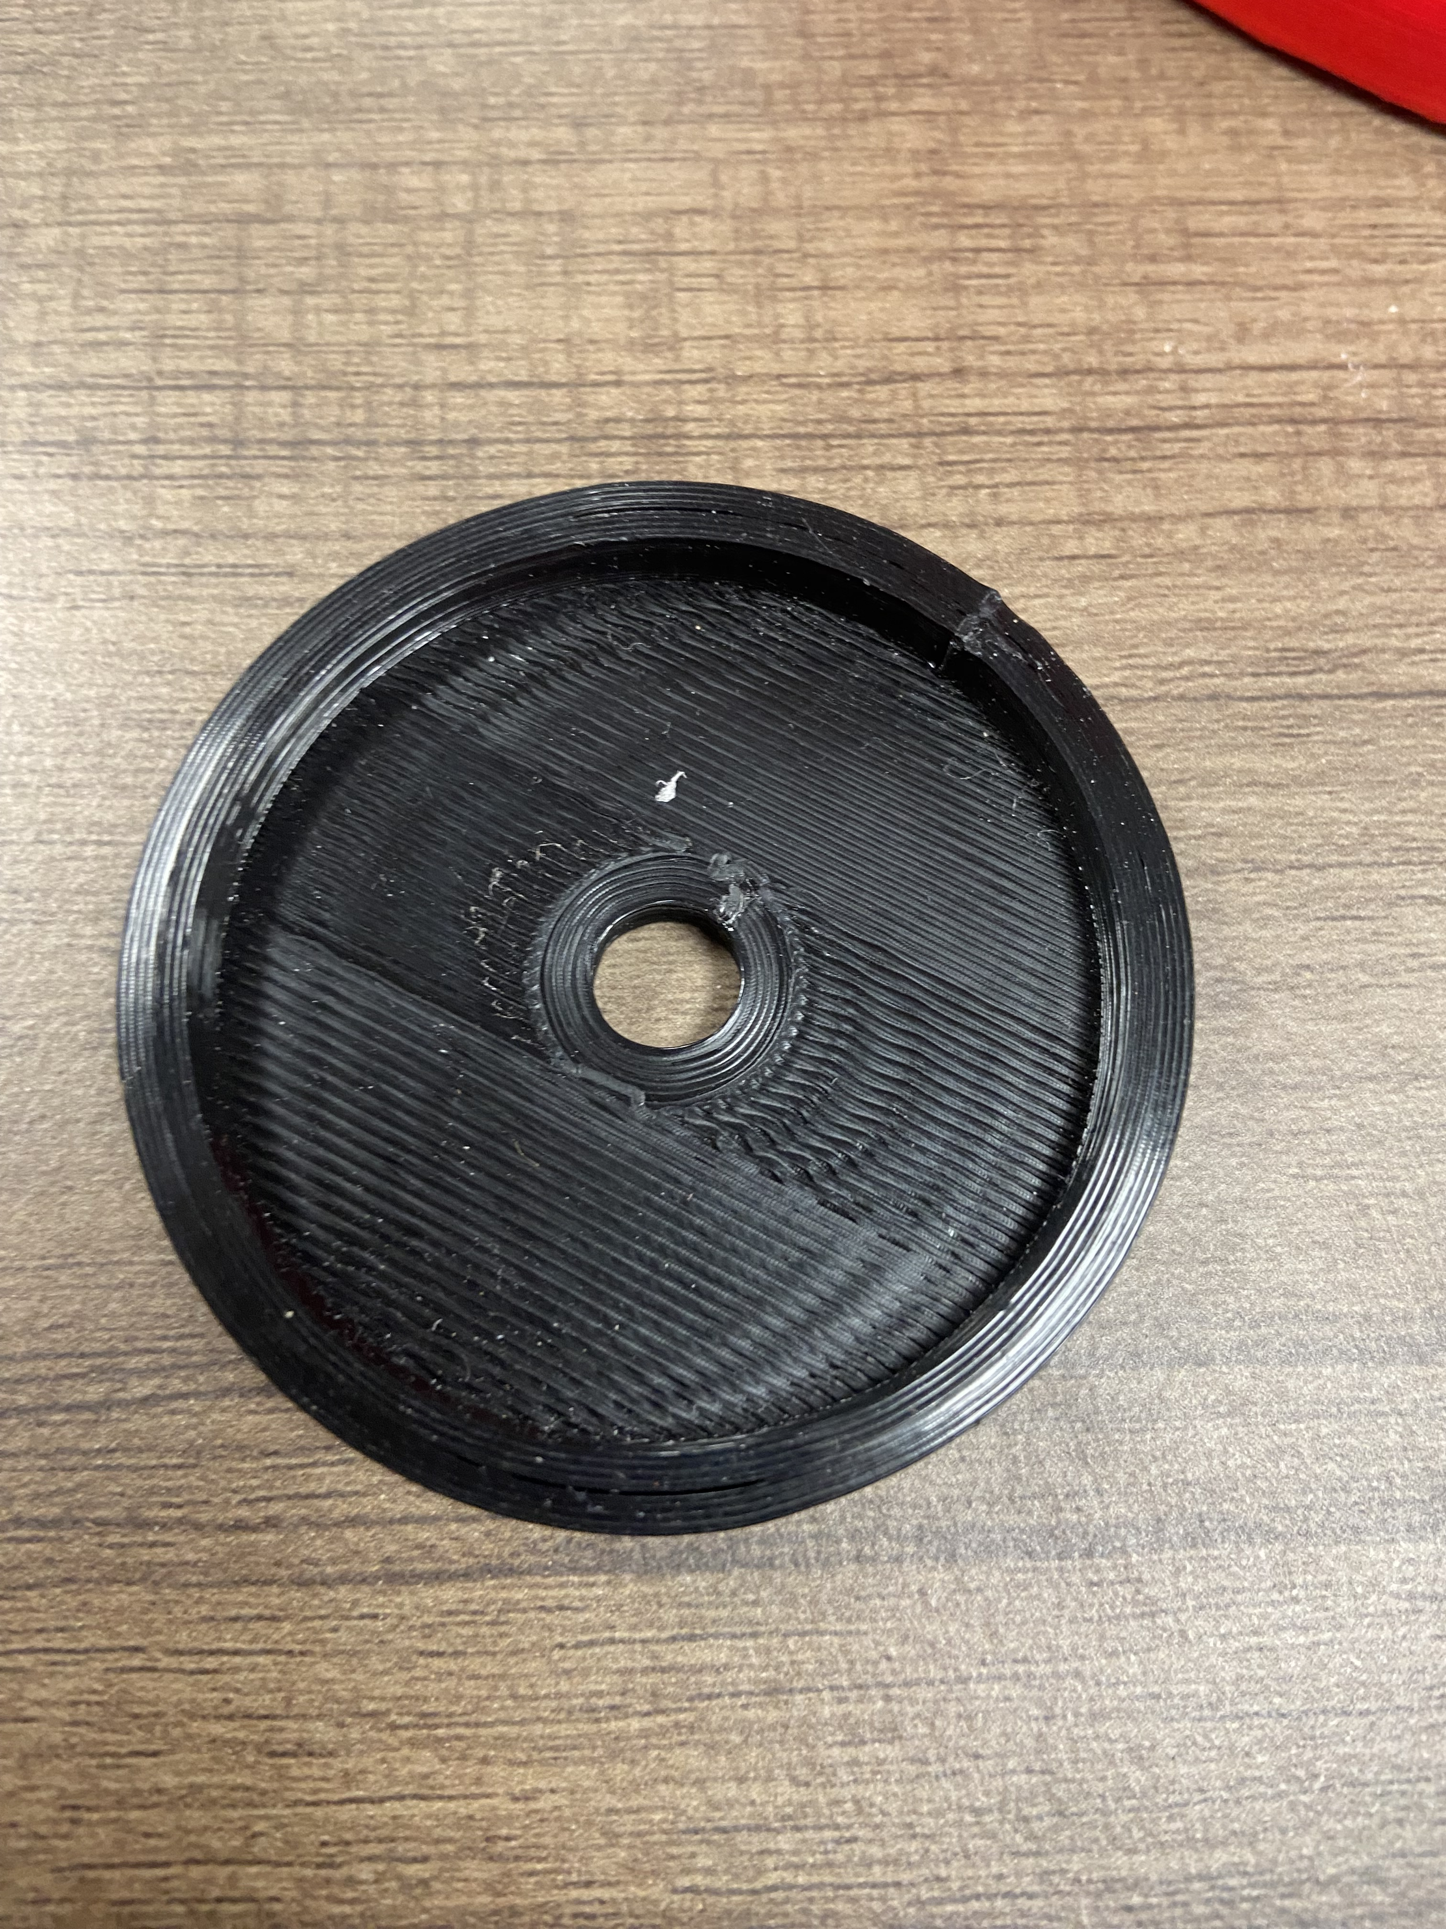
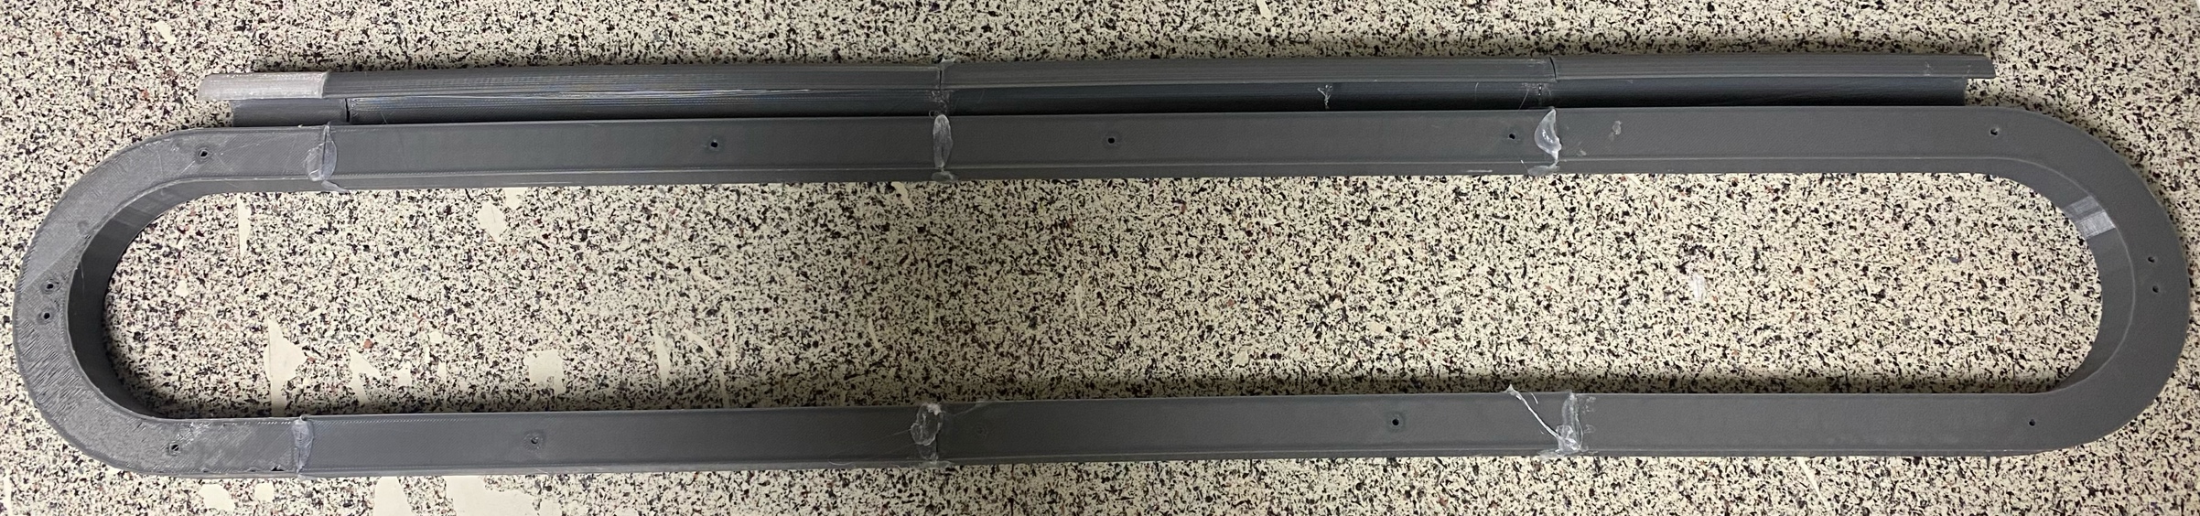
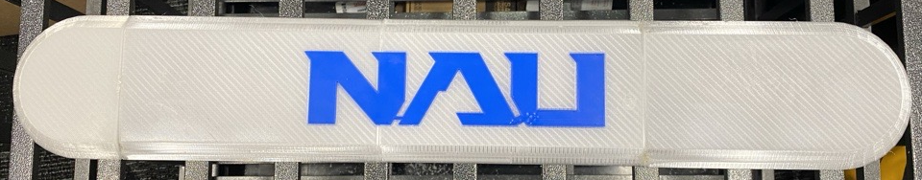
Project Status – Manufacturing Update
Part # | Description | Material | Time to Manufacture | Joint | Picture
22 | Bearing Arm | Aluminum | 5 | 6
23 | Spindle Housing | PLA | 2.8 | 6
24 | Bearing Cup | PLA | 1 | 6
25 | Base/Driver Enclosure | PLA | 36 | 1
26 | Arm Spacer | PLA | 38 | 2
27 | Arm Spacer Cover | PLA | 70 | 2
28 | Side Plate | PLA | 8 | 5

Slide 19

Project Status – Manufacturing Update
Part # | Description | Material | Time to Manufacture | Joint | Picture
29 | Side Spacer | PLA | 6 | 5
30 | Side Cover | PLA | 10 | 5
31 | Stop (2) | PLA | 2 | 2/3
32 | Spacers YGS | PLA | 1 | 2
33 | Motor Spacer | PLA | 1 | 4
34 | Bearing Post Spacer | PLA | 1 | 5
35 | Timing Hub | PLA | 2.8 | 4

Slide 20
Project Status – Manufacturing Update
Part # | Description | Material | Time to Manufacture | Joint | Picture
36 | Limit Switch Spacer | PLA | 1 | 4
37 | Motor Bracket | PLA | 0.5 | 5
38 | Limit Switch Tip | PLA | 0.5 | 6
Total Parts to Manufacture : 38
Total Manufacture Time: 458.5
Completed Manufacture Time: 367.5
Percent Manufacture Completion: 80%

Slide 21
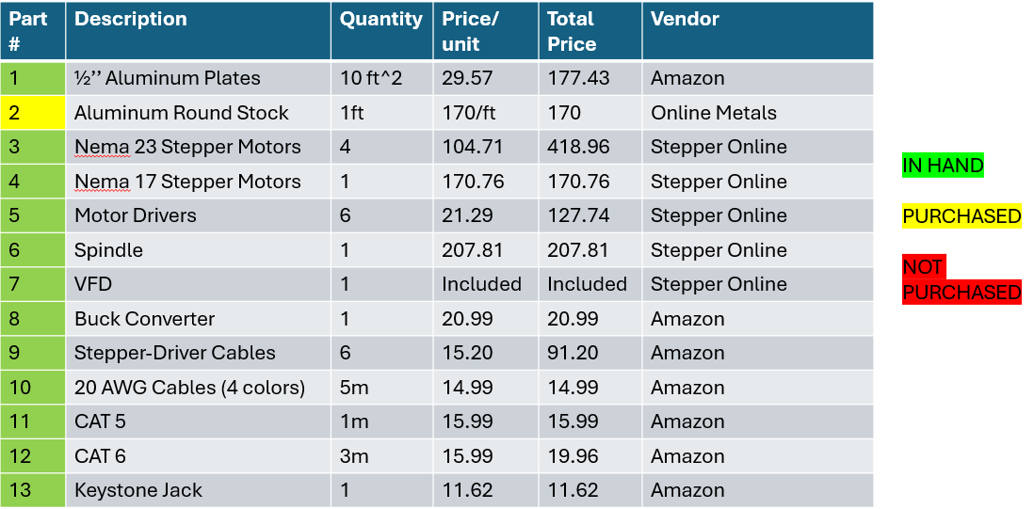
Project Status – Purchasing Update

Slide 22
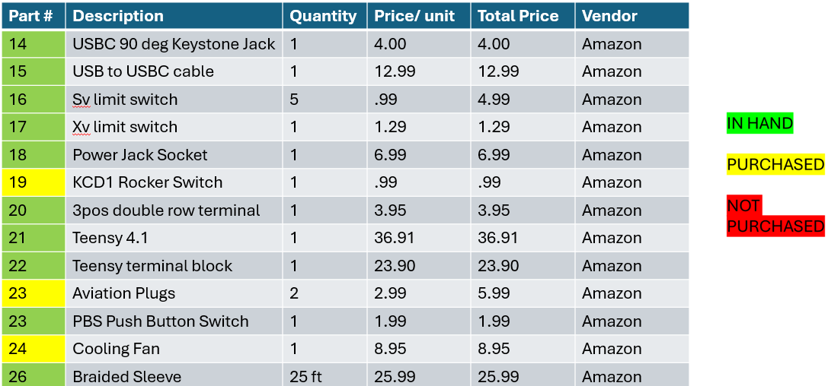
Project Status – Purchasing Update

Slide 23
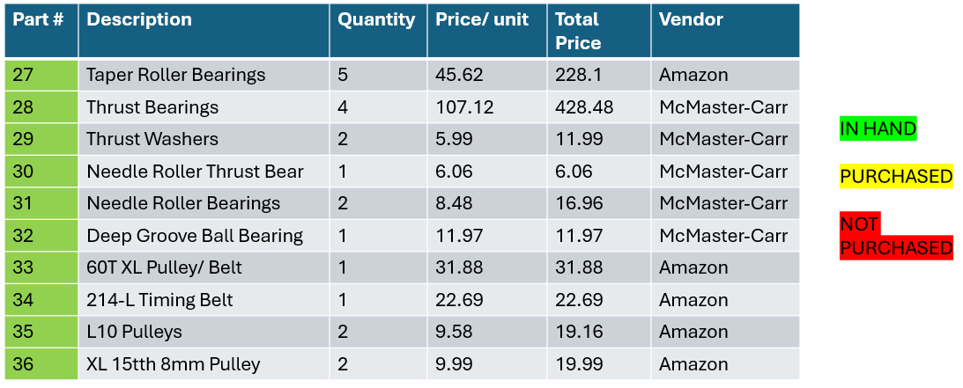
Project Status – Purchasing Update

Slide 24
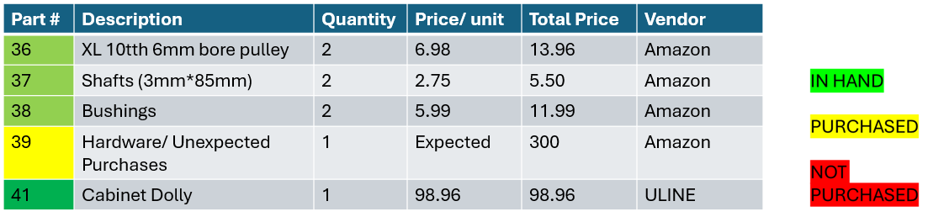
Project Status – Purchasing Update
Total Parts: 41 (excluding multiples of parts)
Percent Purchased: 99%
Need To Purchase: Unforeseen Parts
Total Spent: $4447.49
Remaining Budget: $2552.51

Slide 25
Purchases for Testing
Item | Qty | Price | Vendor | Testing Phase | Purpose
¼’’ Aluminum Plates | 4 | 61.99 | Amazon | Drilling Procedure | Calibrating automated system, spindle test
Carbide Drill Bits | 5 | 33.99 | Drills and Cutters | Drilling Procedure | Find optimal drill bit for operation
Cobalt Drill Bits | 5 | 16.99 | Drills and Cutters | Drilling Procedure | Find optimal drill bit for operation
Multimeter | 1 | 26.98 | Amazon | Current Draw | Ensure adequate current between power supply and motor drivers
Various Gauge Wire | 1 | 15.69 | Amazon | Current Draw | Optimizing design through wire selection
In possession of:
Multimeter
Scrap Wood and Aluminum
Soldering Iron and Equipment
20 AWG Wiring
Arduino Software
Extra Electronic Components for Testing
Variable Power Supply
Total: $155.64

Slide 26
Risk Analysis & Mitigation Plan Joint 1
Type of Failure | Associated Parts | Probability (1-10) | Severity (1-10) | Mitigation
J1 Rotational Stalling | J1 3D Printed Base | 3 | 4 | Lathe out internal walls to improve concentricity
J1 Belt Tensioning Failure | J1 3D Printed Motor Mount | 1 | 2 | Reprint Motor Mount with Greater Adjustability

Slide 27
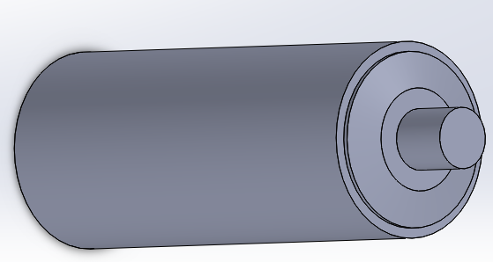
Risk Analysis & Mitigation Plan Joint 2
Type of Failure | Associated Parts | Probability (1-10) | Severity (1-10) | Mitigation | Photos
Arm Deflection | Aluminum machined arm | 4 | 10 | Extreme Thickness of part and mill the least amount of material possible
Belt Tension Failure | J2 Motor | 4 | 7 | Lubrication, ensure tension is correct during testing phase
 | J2 Aluminum Spindle
Torque Failure on Motor | J2 Arm | 3 | 8 | Ensure motor has high enough holding torque
 | J5 Accuracy | 3 | 8
 | J6 Spindle Accuracy | 3 | 8

Slide 28
Risk Analysis & Mitigation Plan Joint 3
Type of Failure | Associated Parts | Probability (1-10) | Severity (1-10) | Mitigation
Belt Tension Failure | J3 Motor | 6 | 8 | Lubrication, ensure tension is correct during testing phase
 | J3 Aluminum Spindle
 | J3 Pulleys
Torque Failure on Motor | J4 Arm | 2 | 6 | Ensure motor has high enough holding torque
 | J5 Accuracy
 | J6 Spindle Accuracy
Bearing Misalignment | J3 Thrust Bearing | 2 | 5 | Press Fit Bearings

Slide 29
Risk Analysis & Mitigation Plan Joint 4
Type of Failure | Associated Parts | Probability (1-10) | Severity (1-10) | Mitigation
Rotational Stalling | J4 Main Shaft | 6 | 8 | Lathe out internal walls to improve concentricity
Belt Tension Failure | J4 Motor Gear | 4 | 6 | Make Guidance Walls taller + Print a thicker or thinner Spacer
 | J4 Spacer
Bearing Misalignment | J4 Needle Thrust Bearing | 2 | 5 | Press Fit Bearings

Slide 30
Risk Analysis & Mitigation Plan Joint 5/6
Type of Failure | Associated Parts | Probability (1-10) | Severity (1-10) | Mitigation
J5 Belt Tension Failure | J5 Tension Guide | 2 | 5 | Remove material from the J5 Housing
J5 Seizing | J5 Tension Guide | 2 | 2 | Lubricant, Brass Bushing or Interests
 | J5 Bearing Post | 4 | 2
 | J5 Carriage | 4 | 2
J6 Severe Spindle Deflection | J6 Spindle Housing | 8 | 2 | Print secondary support cover

Slide 31
Risk Analysis & Mitigation Electrical Design
Type of Failure | Associated Parts | Probability | Severity | Mitigation
Current Overload | Main Power Supply | 3 | 10 | In-Line Fuse
Current Overload | Motor Drivers | 4 | 10 | 150 % Amperage Capability Compared to Rated Currents for Amperage
Short Circuit | Exposed Wiring | 2 | 10 | Properly Seal & Solder all Exposed Wiring
Electrical Grounding Within the System | Magnetic Encoders | 2 | 7 | Correctly Ground Circuit System
Overheating | Teensy 4.1 | 1 | 10 | Cooling Fans for Electrical Housing
Overheating | J1 – J5 Motors | 3 | 10 | Amperage Control for Motors without Constant Load

Slide 32
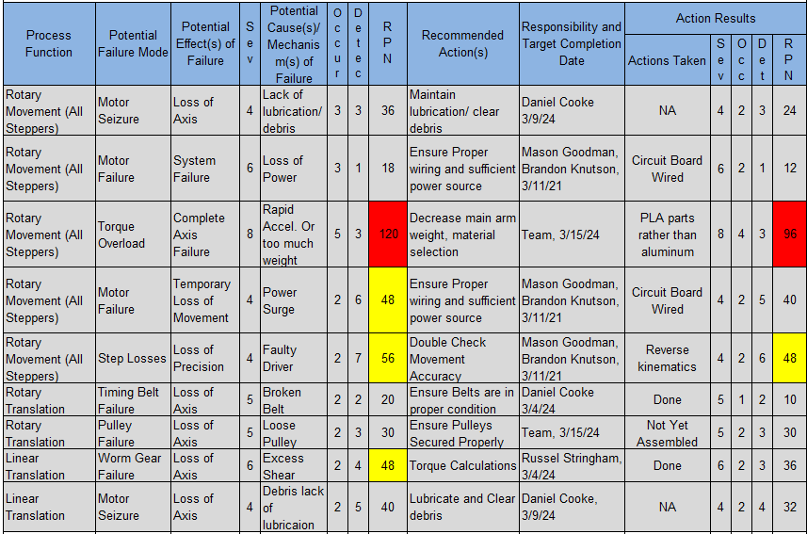
Risk Analysis & Mitigation Plan: Motors and Geared Stages
Points of Concern
Robotic Arm Weight
J2 Torque Output
Power Balance
Mitigation Strategies
FEA Analysis to determine material selection
Shaving weight on large aluminum parts
Surge Protector

Slide 33


Critical Design Element 1
Joint 1 Bearing Alternative to Slewing Drive
Beginning of Project team was unsure of load case for Joint 1
Found possible solution using a Slewing drive
Accurate, Robust, High Gear Gears
However
Expensive, Heavy, and Long Lead times
Alternative Needed
Inspiration from Annin Robotics Design and Professor Willy
Use of two tapered roller thrust bearings and a lipped housing compartment
Accuracy improves with separation distance of bearings

Slide 34


Critical Design Element 2
Joint 2: Alternative Motor for Arm Movement
New Design
Nema 23 100:1 Gearbox Ratio
Old Design
Pros | Cons
High torque | Lead Time
No additional gear system | 2.4 degree backlash
 | 65% efficiency
Nema 23 50:1 Gearbox Ratio
Pros | Cons
High Torque | Addition of gear system
Lighter overall weight | Lower gear ratio
75% efficiency
Addition of gear system

Slide 35

Critical Design Element 3
Reduction in J5 End Effector Weight
Joint Five refers to the robot arm's "wrist" motion
Adding a direct line motor to the Joint 5 would exceed carrying capacity
Again, taking inspiration for Annin Robotics AR4 design and Robot arms such as Comau's NM series
We pushed the Motor for Joint 5 behind joint 3 and 4
Used a linear actuator with a carriage attached to a XL belt
XL Belt was on two pullies one and tensioning idle other rotated the J6 Housing for the Spindle.

Slide 36
Critical Design Element 1: Verification Results
Joint 1 Bearing Alternative to Slewing Drive
Bearing Radial and Axial Load far exceeded Requirements
3D Printer Structure meet Load Requirements
Same can be said for the spindle
All components exceeded a FOS of 10 with a load case of 250lbs

Slide 37


Critical Design Element 2: Verification Result
Joint 2: Alternative Motor for Arm Movement
Will new motor produce enough be efficient?
Addition of gear system with 2.25:1 gear ratio
Gear:
  OD = 2.845
  Number of Teeth = 45
Pinion:
  OD = 1.312
  Number of Teeth = 18
Original Motor Efficiency = $65\%$
New Motor Efficiency = 1.2 Nm * (50*.75) * (2.25*.94)
        = 95.18%
Motor Choice

Slide 38
Critical Design Element 3: Verification Results
Reduction in J5 End Effector Weight
Motor Weight = 1.4 Pounds
J5 Housing Weight
  671 Grams PLA Version
  1451 Grams Aluminum Version
  1.72 lbs Difference
Total Weight Savings = 3.12 Lbs

Slide 39
Summary and Review of Action Items
text

Slide 40
Questions?

Slide 41
Works Cited
Slide 1 Images
https://www.anninrobotics.com/

